Slide 1
Chapter 23 | Southern Great Plains

Slide 2
Ch. 23 | Southern Great Plains
23
Key Message #1
Food, Energy, and Water Resources
Quality of life in the region will be compromised as increasing population, the migration of individuals from rural to urban locations, and a changing climate redistribute demand at the intersection of food consumption, energy production, and water resources. A growing number of adaptation strategies, improved climate services, and early warning decision support systems will more effectively manage the complex regional, national, and transnational issues associated with food, energy, and water.

Slide 3
Ch. 23 | Southern Great Plains
23
Key Message #2
Infrastructure
The built environment is vulnerable to increasing temperature, extreme precipitation, and continued sea level rise, particularly as infrastructure ages and populations shift to urban centers. Along the Texas Gulf Coast, relative sea level rise of twice the global average will put coastal infrastructure at risk. Regional adaptation efforts that harden or relocate critical infrastructure will reduce the risk of climate change impacts.

Slide 4
Ch. 23 | Southern Great Plains
23
Key Message #3
Ecosystems and Ecosystem Services
Terrestrial and aquatic ecosystems are being directly and indirectly altered by climate change. Some species can adapt to extreme droughts, unprecedented floods, and wildfires from a changing climate, while others cannot, resulting in significant impacts to both services and people living in these ecosystems. Landscape-scale ecological services will increase the resilience of the most vulnerable species.

Slide 5
Ch. 23 | Southern Great Plains
23
Key Message #4
Human Health
Health threats, including heat illness and diseases transmitted through food, water, and insects, will increase as temperature rises. Weather conditions supporting these health threats are projected to be of longer duration or occur at times of the year when these threats are not normally experienced. Extreme weather events with resultant physical injury and population displacement are also a threat. These threats are likely to increase in frequency and distribution and are likely to create significant economic burdens. Vulnerability and adaptation assessments, comprehensive response plans, seasonal health forecasts, and early warning systems can be useful adaptation strategies.

Slide 6
Ch. 23 | Southern Great Plains
23
Key Message #5
Indigenous Peoples
Tribal and Indigenous communities are particularly vulnerable to climate change due to water resource constraints, extreme weather events, higher temperature, and other likely public health issues. Efforts to build community resilience can be hindered by economic, political, and infrastructure limitations, but traditional knowledge and intertribal organizations provide opportunities to adapt to the potential challenges of climate change.

Slide 7
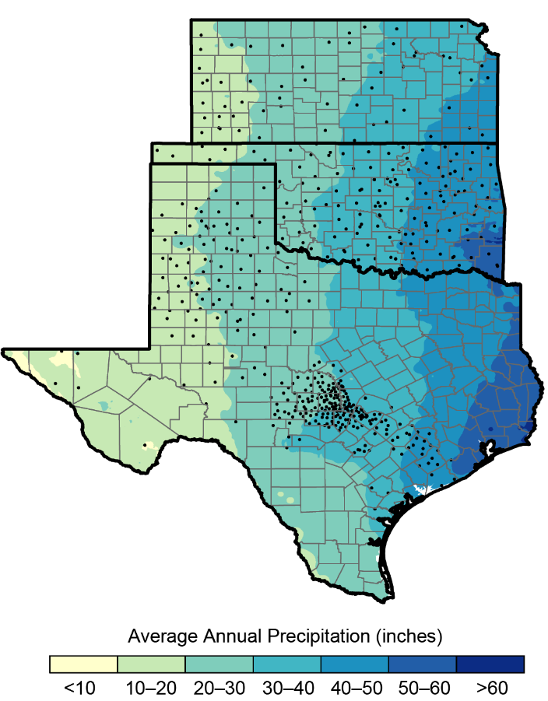
Fig. 23.1: Monitoring Precipitation Across the Southern Great Plains
Ch. 23 | Southern Great Plains
The Southern Great Plains is characterized by a pronounced east–west gradient of precipitation, with wetter conditions prevailing to the east and arid conditions to the west. Precipitation monitoring is critical in this region; state-level Mesonet station networks in Kansas, Oklahoma, and Texas are shown here to illustrate a key aspect of current monitoring capacity. Sources: NOAA NCEI, CICS-NC, and ERT Inc. Data from PRISM Climate group, Oregon State University, http://prism.oregonstate.edu, created July 10, 2010.

Slide 8
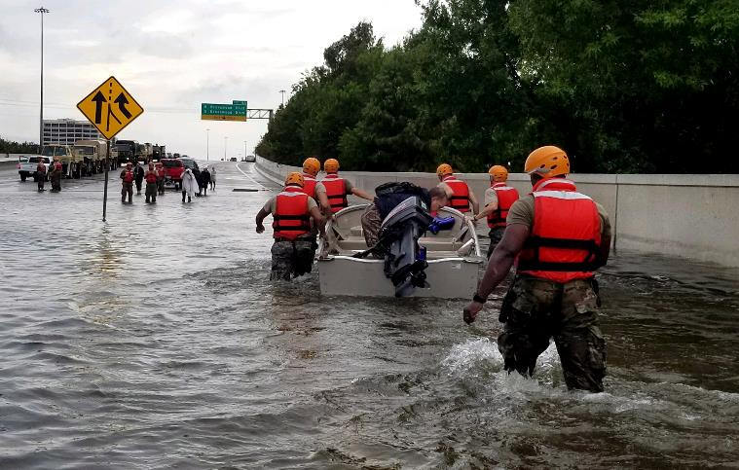
Fig. 23.2: Hurricane Harvey Flooding
Ch. 23 | Southern Great Plains
Texas Army National Guard assisting in flood rescues associated with Hurricane Harvey, August 27, 2017. Photo credit: Lt. Zachary West, Texas National Guard.

Slide 9
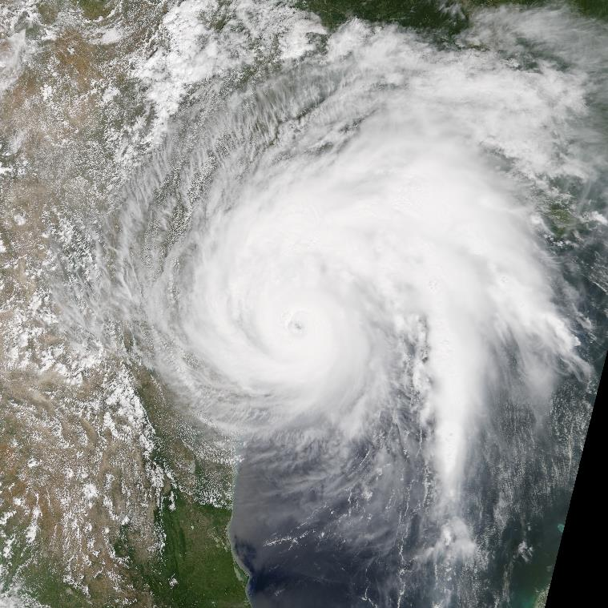
Fig. 23.3: Hurricane Harvey Satellite Image
Ch. 23 | Southern Great Plains
This visible satellite image shows Hurricane Harvey approaching the Texas coast on August 25, 2017. Image credit: NASA Earth Observatory.

Slide 10
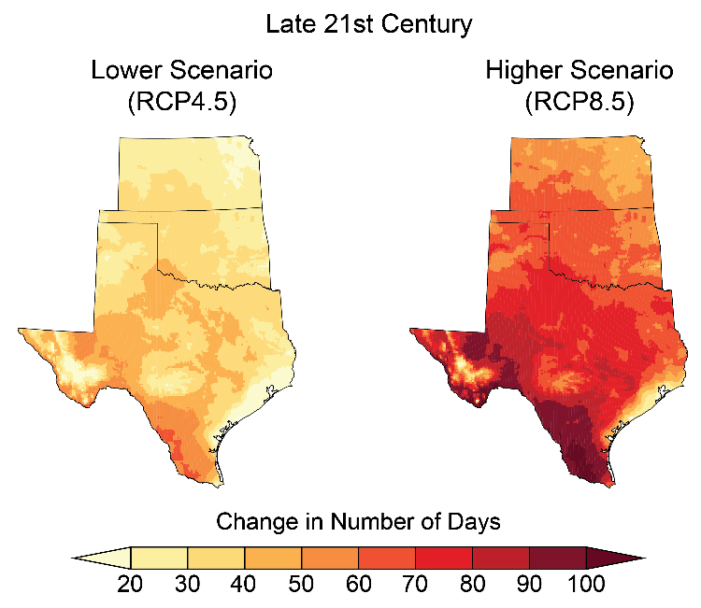
Fig. 23.4: Projected Increase in Number of Days Above 100°F
Ch. 23 | Southern Great Plains
Under both lower- and higher-scenario climate change projections, the number of days exceeding 100°F is projected to increase markedly across the Southern Great Plains by the end of the century (2070–2099 as compared to 1976–2005). Sources: NOAA NCEI and CICS-NC.

Slide 11
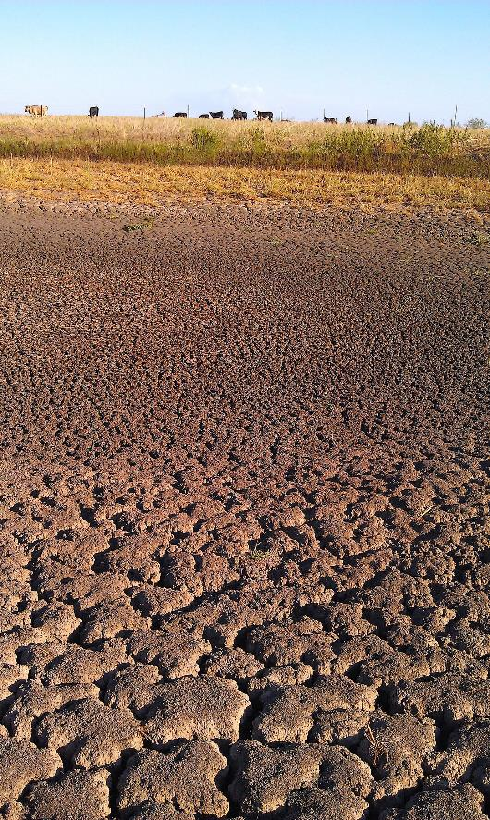
Fig. 23.5: Stock Pond Affected by Drought
Ch. 23 | Southern Great Plains
The photo shows the drought impact on a stock pond near Kurten, Texas, in 2011. Photo credit: John Nielson-Gammon.

Slide 12
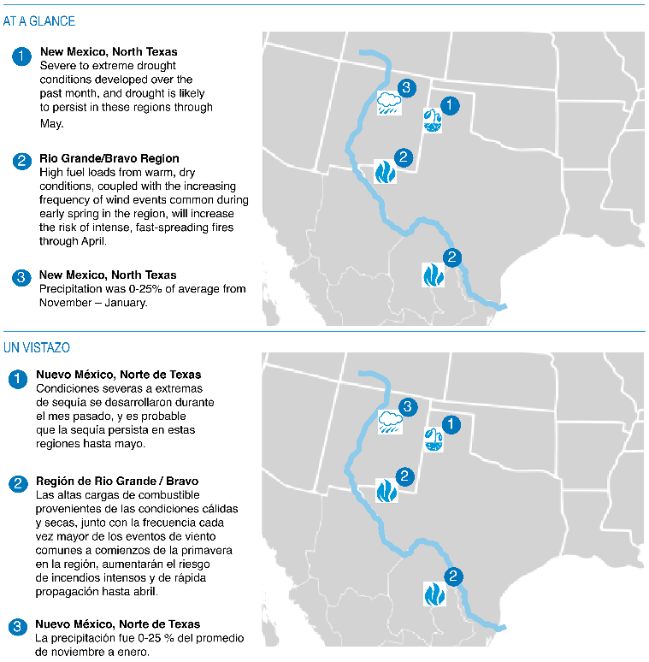
Fig. 23.6: Highlighting Seasonal-Scale Extreme Events in a Transboundary Setting
Ch. 23 | Southern Great Plains
Shown here are the English- and Spanish-language versions of the February 2018 Climate Assessment for the Southwest Rio Grande-Bravo Climate Impacts and Outlook “At a Glance” summary. Sources: Garfin et al. 2018.^{44, 51}
Notes:
44: Garfin, G., S. LeRoy, M. Shafer, M. Muth, V. Murphy, I. Palomo, M. Ibarra, I. Ledesma, A. Chable, R. Pascual, M. Lopez, J. Martinez, D.R. Rangel, and J.S. Colin, 2018: Rio Grande/Bravo: Climate Impacts and Outlook. CLIMAS, Tucson, AZ, 6 pp. http://www.climas.arizona.edu/sites/default/files/Rio_Grande-Bravo_Outlook_February2018.pdf
51: Garfin, G., S. LeRoy, M. Shafer, M. Muth, V. Murphy, I. Palomo, M. Ibarra, I. Ledesma, A. Chable, R. Pascual, M. Lopez, J. Martinez, D.R. Rangel, and J.S. Colin, 2018: Rio Grande/Bravo Impactos Climáticos y Perspectivas. CLIMAS, Tucson, AZ, 6 pp. https://www.climas.arizona.edu/sites/default/files/Rio_Bravo_Perspectiva_Febrero2018.pdf

Slide 13
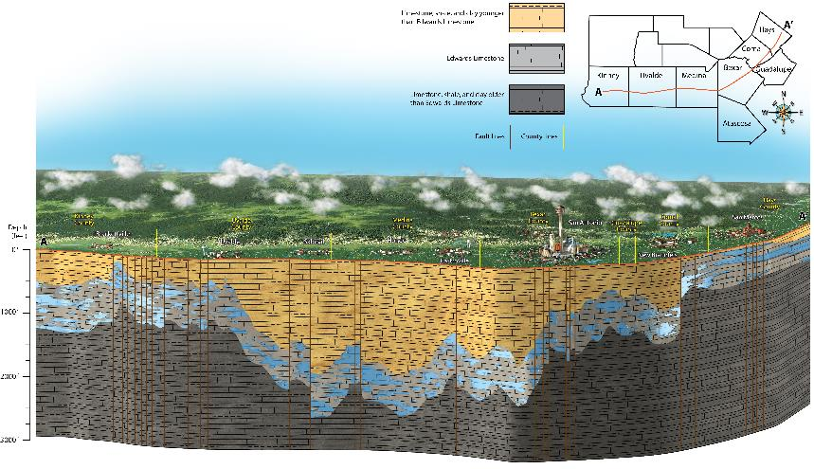
Fig. 23.7: Cross Section of Edwards Aquifer
Ch. 23 | Southern Great Plains
Key characteristics of the Edwards Aquifer, such as relative shallowness and karst features, make it vulnerable to the impacts of both climate variability and climate change. Its importance as a major supplier of groundwater in central Texas makes these vulnerabilities even more pronounced. Source: Edwards Aquifer Authority.⁷⁹ Used with permission.
Notes:
79: Edwards Aquifer Authority, n.d.: The Edwards Aquifer Region. 8 pp. https://cld.bz/bookdata/NHjeYFt/basic-html/page-1.html

Slide 14
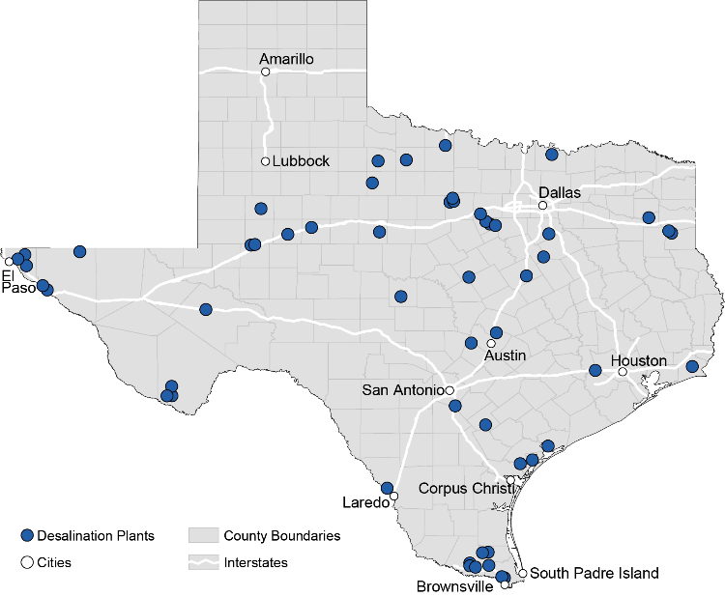
Fig. 23.8: Texas Desalination Plants
Ch. 23 | Southern Great Plains
Desalination activities in Texas are an important contributor to the state’s efforts to meet current and projected water needs for communities, industry, and agriculture. Source: adapted from Texas Water Development Board 2017.¹¹⁰
Notes:
Texas Water Development Board, 2017: Public Water Supply Desalination Plant Capacities [infographic]. Austin, TX, accessed 03 March 2018. https://www.twdb.texas.gov/innovativewater/desal/doc/maps/DesalCap_20170925.pdf?d=12553.399999975227

Slide 15
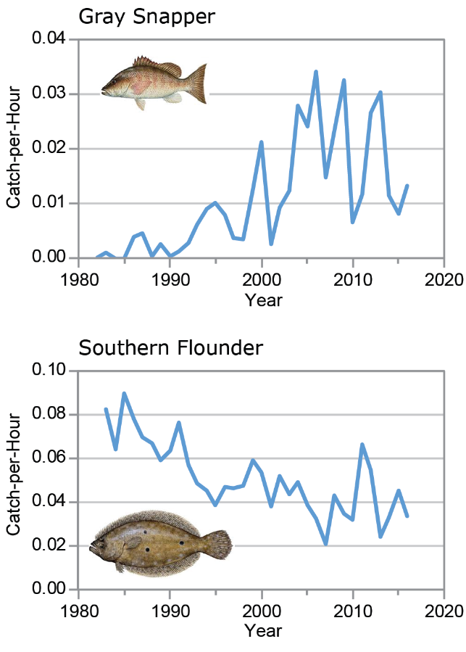
Fig. 23.9: Climate Winners and Losers (Gray Snapper and Southern Flounder)
Ch. 23 | Southern Great Plains
The graphs show trends in annual abundance of (top) gray snapper and (bottom) southern flounder as the number of fish caught per hour along the Gulf Coast of Texas between 1982 (snapper)/1983 (flounder) and 2016. As water temperatures increase along the Texas Gulf Coast, gray snapper are expanding northward along the Texas coast, while southern flounder, a popular sport fish, are becoming less abundant, impacting the recreational and commercial fishing industries. Source: Texas Parks and Wildlife Department.

Slide 16
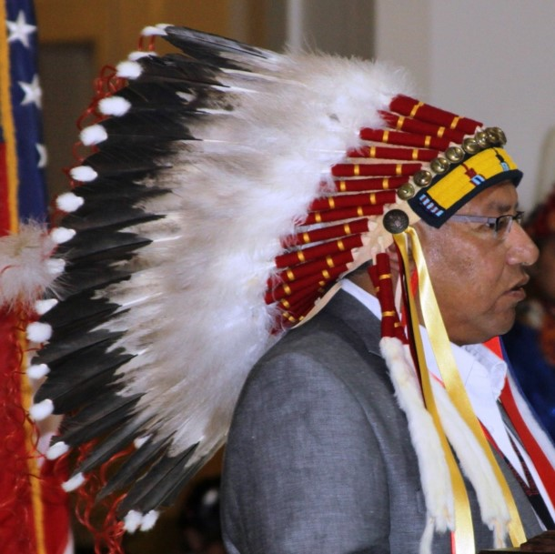
Fig. 23.10: Cheyenne Sun Dance Ceremony
Ch. 23 | Southern Great Plains
Chief Gordon Yellowman is shown here representing the Cheyenne Tribe at a traditional speaking engagement. Photo courtesy of Gordon L. Yellowman, Sr.

Slide 17
Ch. 23 | Southern Great Plains
23
Chapter Author Team
Federal Coordinating Lead Author
Bill Bartush, U.S. Fish and Wildlife Service
Chapter Lead
Kevin Kloesel, University of Oklahoma
Chapter Authors
Jay Banner, University of Texas at Austin
David Brown, USDA-ARS Grazinglands Research Laboratory
Jay Lemery, University of Colorado
Xiaomao Lin, Kansas State University
Cindy Loeffler, Texas Parks and Wildlife Department
Gary McManus, Oklahoma Climatological Survey
Esther Mullens, DOI South Central
Climate Adaptation Science Center
John Nielsen-Gammon, Texas A&M University
Mark Shafer, NOAA-RISA Southern Climate Impacts Planning Program
Cecilia Sorensen, University of Colorado
Sid Sperry, Oklahoma Association of Electric Cooperatives
Daniel Wildcat, Haskell Indian Nations University
Jadwiga Ziolkowska, University of Oklahoma
Review Editor
Ellu Nasser, Adaptation International

Slide 18
Ch. 23 | Southern Great Plains
23
Acknowledgments
Technical Contributor
Katharine Hayhoe, Texas Tech University
USGCRP Coordinators
Susan Aragon-Long, Senior Scientist
Christopher W. Avery, Senior Manager

Slide 19
Kloesel, K., B. Bartush, J. Banner, D. Brown, J. Lemory, X. Lin, G. McManus, E. Mullens, J. Nielsen-Gammon, M. Shafer, C. Sorenson, S. Sperry, D. Wildcat, and J. Ziolkowska, 2018: Southern Great Plains. In Impacts, Risks, and Adaptation in the United States: Fourth National Climate Assessment, Volume II [Reidmiller, D.R., C.W. Avery, D.R. Easterling, K.E. Kunkel, K.L.M. Lewis, T.K. Maycock, and B.C. Stewart (eds.)]. U.S. Global Change Research Program, Washington, DC, USA. doi: 10.7930/NCA4.2018.CH23
https://nca2018.globalchange.gov/chapter/southern-great-plains

