Slide 1
Chapter 16 | Climate Effects on U.S. International Interests

Slide 2
Ch. 16 | Climate Effects on U.S. International Interests
16
Key Message #1
Economics and Trade
The impacts of climate change, variability, and extreme events outside the United States are affecting and are virtually certain to increasingly affect U.S. trade and economy, including import and export prices and businesses with overseas operations and supply chains.

Slide 3
Ch. 16 | Climate Effects on U.S. International Interests
16
Key Message #2
International Development and Humanitarian Assistance
The impacts of climate change, variability, and extreme events can slow or reverse social and economic progress in developing countries, thus undermining international aid and investments made by the United States and increasing the need for humanitarian assistance and disaster relief. The United States provides technical and financial support to help developing countries better anticipate and address the impacts of climate change, variability, and extreme events.

Slide 4
Ch. 16 | Climate Effects on U.S. International Interests
16
Key Message #3
Climate and National Security
Climate change, variability, and extreme events, in conjunction with other factors, can exacerbate conflict, which has implications for U.S. national security. Climate impacts already affect U.S. military infrastructure, and the U.S. military is incorporating climate risks in its planning.

Slide 5
Ch. 16 | Climate Effects on U.S. International Interests
16
Key Message #4
Transboundary Resources
Shared resources along U.S. land and maritime borders provide direct benefits to Americans and are vulnerable to impacts from a changing climate, variability, and extremes. Multinational frameworks that manage shared resources are increasingly incorporating climate risk in their transboundary decision-making processes.

Slide 6
Fig. 16.1: Impact of 2011 Thailand Flooding on U.S. Business Interests
Ch. 16 | Climate Effects on U.S. International Interests
Severe flooding in Thailand in 2011 created significant disruptions of local business operations and global supply chains, resulting in a range of impacts to U.S. business interests. Source: ICF.

Slide 7
Fig. 16.2: Famine Early Warning Systems Network
Ch. 16 | Climate Effects on U.S. International Interests
The Famine Early Warning Systems Network involves a collaboration between U.S. government agencies, other national government ministries, and international partners to collect data and produce analyses of conditions in food-insecure regions and countries. The analyses integrate information on climate, agricultural production, prices, trade, nutrition, and other societal factors to develop scenarios of food security around the world 6 to 12 months in advance. This map shows projections of peak populations in need of emergency food assistance in 2018. Source: adapted from USAID 2018.⁵⁸
Notes:
58: FEWS NET, 2018: Large Assistance Needs and Famine Risk Continue in 2018 [Infographic]. Famine Early Warning System Network (FEWS NET) and U.S. Agency for International Development. https://fews.net/sites/default/files/Food_assistance_needs_Peak_Needs_2018-Final.pdf

Slide 8
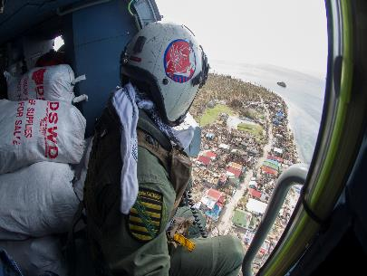
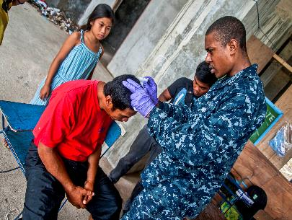
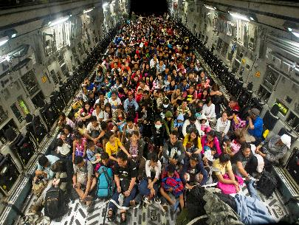
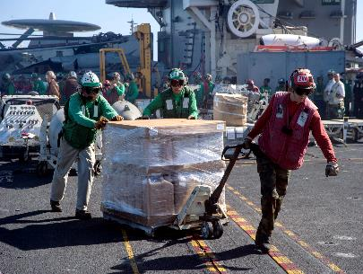
Fig. 16.3: U.S. Military Relief Efforts in Response to Typhoon Haiyan
Ch. 16 | Climate Effects on U.S. International Interests
The U.S. military conducted humanitarian and disaster relief efforts in the aftermath of Typhoon Haiyan in the Philippines in 2013. (upper left) An officer aboard an MH-60R Seahawk helicopter prepares to drop off humanitarian supplies. (upper right) A sailor assists a Philippine nurse in treating a patient's head wound at the Immaculate Conception School refugee camp. (lower left) Residents displaced by the storm fill the cargo hold of a C-17 Globemaster aircraft. (lower right) Sailors aboard the aircraft carrier USS George Washington move a pallet of drinking water across the flight deck. Photo credit: U.S. Department of Defense.

Slide 9
Fig. 16.4: Transboundary Climate-Related Impacts
Ch. 16 | Climate Effects on U.S. International Interests
Shown here are examples of climate-related impacts spanning U.S. national borders. (left) The North American Drought Monitor map for June 2011 shows drought conditions along the US–Mexico border. Darker colors indicate greater intensity of drought (the letters A and H indicate agricultural and hydrological drought, respectively). (right) Smoke from Canadian wildfires in 2017 was detected by satellite sensors built to detect aerosols in the atmosphere. The darker orange areas indicate higher concentrations of smoke and hazy conditions moving south from British Columbia to the United States. Sources: (left) adapted from NOAA 2018,¹¹⁴ (right) adapted from NOAA 2018.¹¹⁵
Notes:
114: NOAA, North American Drought Monitor in June 2011. NOAA National Climatic Data Center, Asheville, NC. https://www.ncdc.noaa.gov/temp-and-precip/drought/nadm/maps/en/201106#map-selection
115: NOAA, Smoke from Canadian Wildfires Travels Over United States [image]. National Oceanic and Atmospheric Administration. https://www.nnvl.noaa.gov/images/high_resolution/2082v1_20170817-AERO.png

Slide 10
Ch. 16 | Climate Effects on U.S. International Interests
16
Chapter Author Team
Federal Coordinating Lead Author
Meredith Muth, National Oceanic and Atmospheric Administration
Chapter Lead
Joel B. Smith, Abt Associates
Chapter Authors
Alice Alpert, U.S. Department of State
James L. Buizer, University of Arizona
Jonathan Cook, U.S. Agency for International Development
Apurva Dave, U.S. Global Change Research Program/ICF
John Furlow, International Research Institute for Climate and Society, Columbia University
Kurt Preston, U.S. Department of Defense
Peter Schultz, ICF
Lisa Vaughan, National Oceanic and Atmospheric Administration
Review Editor
Diana Liverman, University of Arizona

Slide 11
Ch. 16 | Climate Effects on U.S. International Interests
16
Acknowledgments
USGCRP Coordinator
Apurva Dave, International Coordinator and Senior Analyst

Slide 12
Smith, J.B., M. Muth, A. Alpert, J.L. Buizer, J. Cook, A. Dave, J. Furlow, K. Preston, P. Schultz, and L. Vaughan, 2018: Climate Effects on U.S. International Interests. In Impacts, Risks, and Adaptation in the United States: Fourth National Climate Assessment, Volume II [Reidmiller, D.R., C.W. Avery, D.R. Easterling, K.E. Kunkel, K.L.M. Lewis, T.K. Maycock, and B.C. Stewart (eds.)]. U.S. Global Change Research Program, Washington, DC, USA. doi: 10.7930/NCA4.2018.CH16
https://nca2018.globalchange.gov/chapter/international

