Slide 1
Chapter 12 | Transportation

Slide 2
Ch. 12 | Transportation
12
Key Message #1
Transportation at Risk
A reliable, safe, and efficient U.S. transportation system is at risk from increases in heavy precipitation, coastal flooding, heat, wildfires, and other extreme events, as well as changes to average temperature. Throughout this century, climate change will continue to pose a risk to U.S. transportation infrastructure, with regional differences.

Slide 3
Ch. 12 | Transportation
12
Key Message #2
Impacts to Urban and Rural Transportation
Extreme events that increasingly impact the transportation network are inducing societal and economic consequences, some of which disproportionately affect vulnerable populations. In the absence of intervention, future changes in climate will lead to increasing transportation challenges, particularly because of system complexity, aging infrastructure, and dependency across sectors.

Slide 4
Ch. 12 | Transportation
12
Key Message #3
Vulnerability Assessments
Engineers, planners, and researchers in the transportation field are showing increasing interest and sophistication in understanding the risks that climate hazards pose to transportation assets and services. Transportation practitioner efforts demonstrate the connection between advanced assessment and the implementation of adaptive measures, though many communities still face challenges and barriers to action.

Slide 5
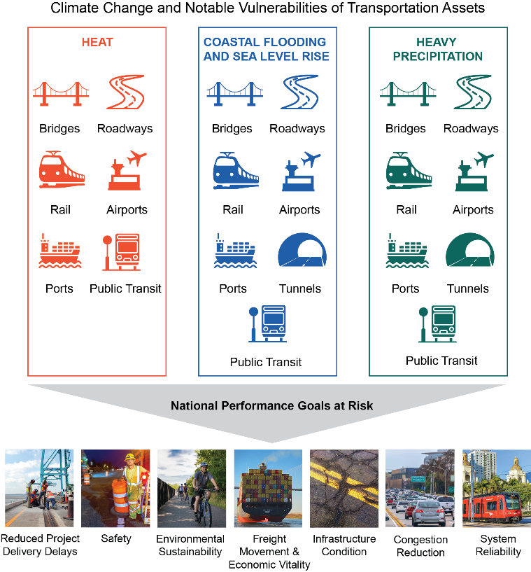
Fig. 12.1: U.S. Transportation Assets and Goals at Risk
Ch. 12 | Transportation
Heavy precipitation, coastal flooding, heat, and changes in average precipitation and temperature affect assets (such as roads and bridges) across all modes of transportation. The figure shows major climate-related hazards and the transportation assets impacted. Photos illustrate national performance goals (listed in 23 U.S.C. § 150⁸) that are at risk due to climate-related hazards. Source: USGCRP. Photo credits from left to right: JAXPORT, Meredith Fordham Hughes [CC BY-NC 2.0]; Oregon Department of Transportation [CC BY 2.0]; NPS–Mississippi National River and Recreation Area; Flickr user Tom Driggers [CC BY 2.0]; Flickr user Mike Mozart [CC BY 2.0]; Flickr user Jeff Turner [CC BY 2.0]; Flickr user William Garrett [CC BY 2.0].
Notes:
8: National Goals and Performance Management Measures. 23 U.S.C. § 150. http://uscode.house.gov/view.xhtml?req=(title:23%20section:150%20edition:prelim)

Slide 6
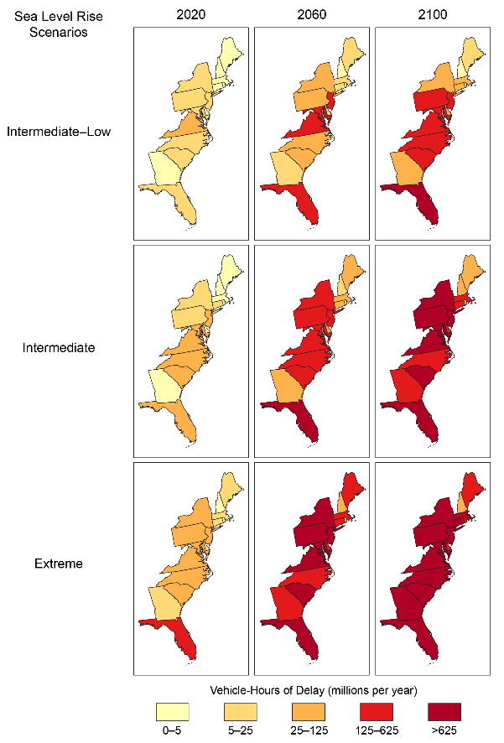
Fig. 12.2: Annual Vehicle-Hours of Delay Due to High Tide Flooding
Ch. 12 | Transportation
The figure shows annual vehicle-hours of delay for major roads (principal arterials, minor arterials, and major collectors) due to high tide flooding by state, year, and sea level rise scenario (from Sweet et al. 2017).⁵⁹ Years are shown using decadal average (10-year) values (that is, 2020 is 2016–2025), except 2100, which is a 5-year average (2096–2100). One vehicle-hour of delay is equivalent to one vehicle delayed for one hour. Source: Jacobs et al. 2018,⁶¹ Figure 3, reproduced with permission of the Transportation Research Board.
Notes:
59: Sweet, W.V., R. Horton, R.E. Kopp, A.N. LeGrande, and A. Romanou, 2017: Sea level rise. Climate Science Special Report: Fourth National Climate Assessment, Volume I. Wuebbles, D.J., D.W. Fahey, K.A. Hibbard, D.J. Dokken, B.C. Stewart, and T.K. Maycock, Eds. U.S. Global Change Research Program, Washington, DC, USA, 333-363. http://dx.doi.org/10.7930/J0VM49F2
61: Jacobs, J.M., L.R. Cattaneo, W. Sweet, and T. Mansfield, 2018: Recent and future outlooks for nuisance flooding impacts on roadways on the US East Coast. Transportation Research Record. http://dx.doi.org/10.1177/0361198118756366

Slide 7
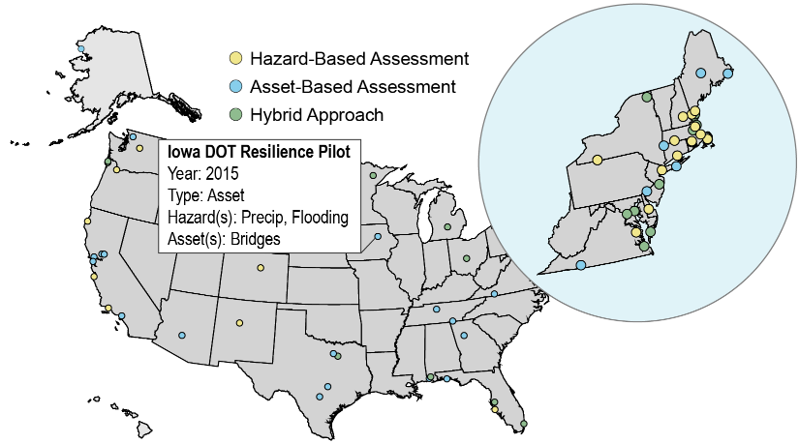
Fig. 12.3: Transportation Vulnerability and Risk Assessments
Ch. 12 | Transportation
This figure shows transportation vulnerability and/or risk assessments from 2012 to 2016 by location. Cumulatively, these vulnerability assessments elucidate national-scale vulnerabilities and progress. Data for the U.S. Caribbean region were not available. See the online version of this map at http://nca2018.globalchange.gov/chapter/12#fig-12-3 to access the complete set of vulnerability and risk assessments. Sources: ICF and U.S. Department of Transportation.

Slide 8
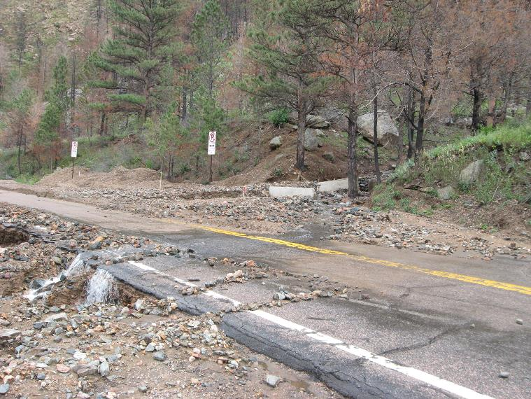
Fig. 12.4: Flood Impacts on Colorado Highway
Ch. 12 | Transportation
Flooding events can result in serious damage to road infrastructure. Here, debris flow covers US Highway 14 (Poudre Canyon) after the High Park Fire in 2012. Photo credit: Justin Pipe, Colorado Department of Transportation.

Slide 9
Ch. 12 | Transportation
12
Chapter Author Team
Federal Coordinating Lead Author
Michael Culp, U.S. Department of Transportation, Federal Highway Administration
Chapter Lead
Jennifer M. Jacobs, University of New Hampshire
Chapter Authors
Lia Cattaneo, Harvard University (formerly U.S. Department of Transportation)
Paul Chinowsky, University of Colorado Boulder
Anne Choate, ICF
Susanne DesRoches, New York City Mayor’s Office of Recovery and Resiliency and Office of Sustainability
Scott Douglass, South Coast Engineers
Rawlings Miller, WSP, (formerly U.S. Department of Transportation Volpe Center)
Review Editor
Jesse Keenan, Harvard University

Slide 10
Ch. 12 | Transportation
12
Acknowledgments
USGCRP Coordinators
Allyza Lustig, Program Coordinator
Kristin Lewis, Senior Scientist

Slide 11
Jacobs, J.M., M. Culp, L. Cattaneo, P. Chinowsky, A. Choate, S. DesRoches, S. Douglass, and R. Miller, 2018: Transportation. In Impacts, Risks, and Adaptation in the United States: Fourth National Climate Assessment, Volume II [Reidmiller, D.R., C.W. Avery, D.R. Easterling, K.E. Kunkel, K.L.M. Lewis, T.K. Maycock, and B.C. Stewart (eds.)]. U.S. Global Change Research Program, Washington, DC, USA. doi: 10.7930/NCA4.2018.CH12
https://nca2018.globalchange.gov/chapter/transportation

