Slide 1
Chapter 7 | Ecosystems, Ecosystem Services, and Biodiversity

Slide 2
Ch. 7 | Ecosystems, Ecosystem Services, and Biodiversity
7
Key Message #1
Impacts on Species and Populations
Climate change continues to impact species and populations in significant and observable ways. Terrestrial, freshwater, and marine organisms are responding to climate change by altering individual characteristics, the timing of biological events, and their geographic ranges. Local and global extinctions may occur when climate change outpaces the capacity of species to adapt.

Slide 3
Ch. 7 | Ecosystems, Ecosystem Services, and Biodiversity
7
Key Message #2
Impacts on Ecosystems
Climate change is altering ecosystem productivity, exacerbating the spread of invasive species, and changing how species interact with each other and with their environment. These changes are reconfiguring ecosystems in unprecedented ways.

Slide 4
Ch. 7 | Ecosystems, Ecosystem Services, and Biodiversity
7
Key Message #3
Ecosystem Services at Risk
The resources and services that people depend on for their livelihoods, sustenance, protection, and well-being are jeopardized by the impacts of climate change on ecosystems. Fundamental changes in agricultural and fisheries production, the supply of clean water, protection from extreme events, and culturally valuable resources are occurring.

Slide 5
Ch. 7 | Ecosystems, Ecosystem Services, and Biodiversity
7
Key Message #4
Challenges for Natural Resource Management
Traditional natural resource management strategies are increasingly challenged by the impacts of climate change. Adaptation strategies that are flexible, consider interacting impacts of climate and other stressors, and are coordinated across landscape scales are progressing from theory to application. Significant challenges remain to comprehensively incorporate climate adaptation planning into mainstream natural resource management, as well as to evaluate the effectiveness of implemented actions.

Slide 6
Table 7.1: Key Messages from the Third National Climate Assessment Ecosystems, Biodiversity, and Ecosystem Services Chapter
Ch. 7 | Ecosystems, Ecosystem Services, and Biodiversity
Climate change impacts on ecosystems reduce their ability to improve water quality and regulate water flows.
Climate change, combined with other stressors, is overwhelming the capacity of ecosystems to buffer the impacts from extreme events like fires, floods, and storms.
Landscapes and seascapes are changing rapidly, and species, including many iconic species, may disappear from regions where they have been prevalent or become extinct, altering some regions so much that their mix of plant and animal life will become almost unrecognizable.
Timing of critical biological events, such as spring bud burst, emergence from overwintering, and the start of migrations, has shifted, leading to important impacts on species and habitats.
Whole system management is often more effective than focusing on one species at a time, and can help reduce the harm to wildlife, natural assets, and human well-being that climate disruption might cause.
Key Findings from the Third National Climate Assessment Ecosystems, Biodiversity, and Ecosystem Services Chapter²
Notes:
2: Groffman, P.M., P. Kareiva, S. Carter, N.B. Grimm, J. Lawler, M. Mack, V. Matzek, and H. Tallis, 2014: Ch. 8: Ecosystems, Biodiversity, and Ecosystem Services. Climate Change Impacts in the United States: The Third National Climate Assessment. Melillo, J.M., Terese (T.C.) Richmond, and G.W. Yohe, Eds. U.S. Global Change Research Program, Washington, DC, 195-219. http://dx.doi.org/10.7930/J0TD9V7H

Slide 7
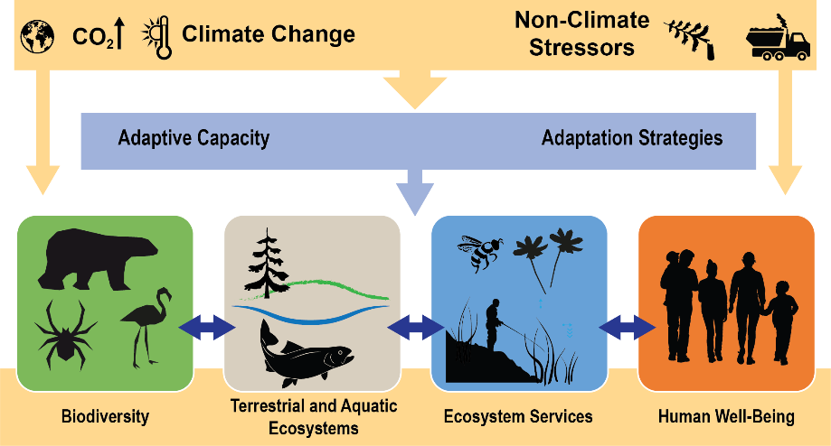
Fig. 7.1: Climate Change, Ecosystems, and Ecosystem Services
Ch. 7 | Ecosystems, Ecosystem Services, and Biodiversity
Climate and non-climate stressors interact synergistically on biological diversity, ecosystems, and the services they provide for human well-being. The impact of these stressors can be reduced through the ability of organisms to adapt to changes in their environment, as well as through adaptive management of the resources upon which humans depend. Biodiversity, ecosystems, ecosystem services, and human well-being are interconnected: biodiversity underpins ecosystems, which in turn provide ecosystem services; these services contribute to human well-being. Ecosystem structure and function can also influence the biodiversity in a given area. The use of ecosystem services by humans, and therefore the well-being humans derive from these services, can have feedback effects on ecosystem services, ecosystems, and biodiversity. Sources: NOAA; USGS; DOI.

Slide 8
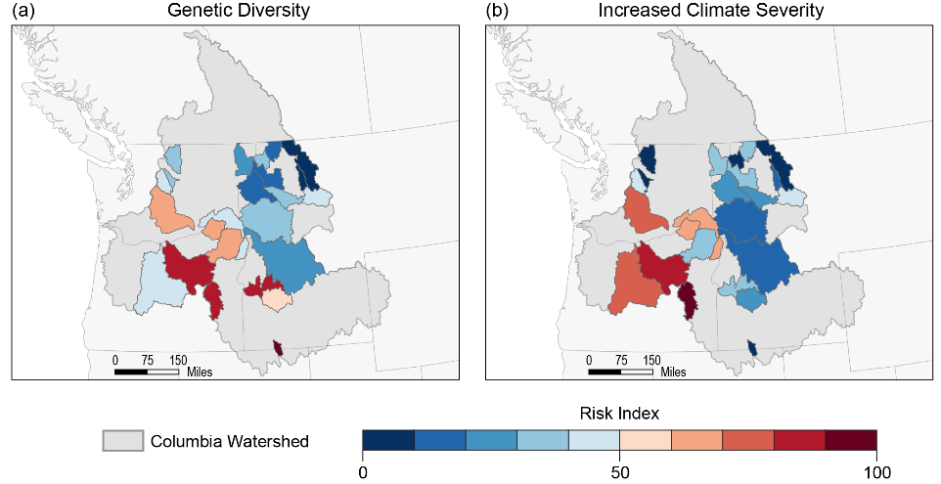
Fig. 7.2: Genetic Diversity and Climate Exposure
Ch. 7 | Ecosystems, Ecosystem Services, and Biodiversity
Genetic diversity is the fundamental basis of adaptive capacity. Throughout the Pacific Northwest, (a) bull trout genetic diversity is lowest in the same areas where (b) climate exposure is highest; in this case, climate exposure is a combination of maximum temperature and winter flood risk. Sub-regions within the broader Columbia River Basin (shaded gray) represent different watersheds used in the vulnerability analysis. Values are ranked by threat, such that the low genetic diversity and high climate exposure are both considered “high” threats (indicated as red in the color gradient). Source: adapted from Kovach et al. 2015.¹⁵
Notes:
15: Kovach, R.P., C.C. Muhlfeld, A.A. Wade, B.K. Hand, D.C. Whited, P.W. DeHaan, R. Al-Chokhachy, and G. Luikart, 2015: Genetic diversity is related to climatic variation and vulnerability in threatened bull trout. Global Change Biology, 21 (7), 2510-2524. http://dx.doi.org/10.1111/gcb.12850

Slide 9
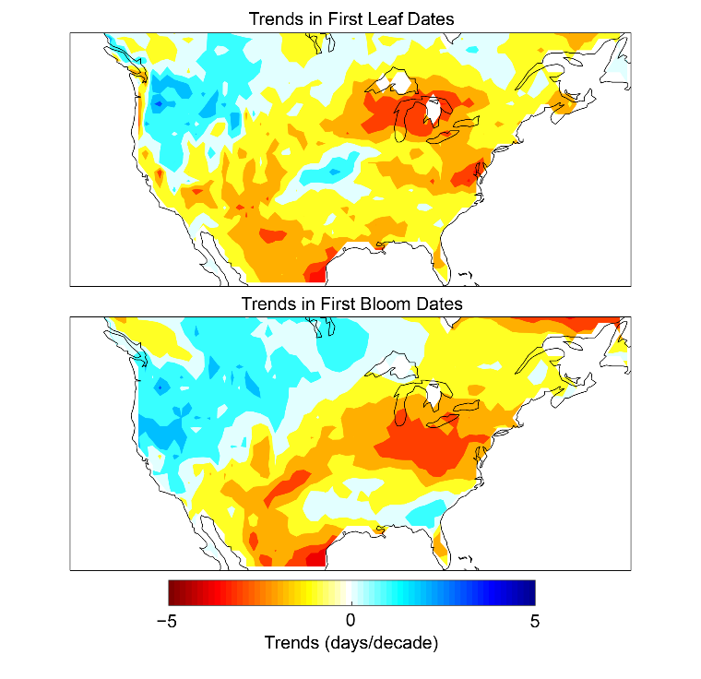
Fig. 7.3: Trends in First Leaf and First Bloom Dates
Ch. 7 | Ecosystems, Ecosystem Services, and Biodiversity
These maps show observed changes in timing of the start of spring over the period 1981–2010, as represented by (top) an index of first leaf date (the average date when leaves first appear on three indicator plants) and (bottom) an index of first bloom date (the average date when blossoms first appear on three indicator plants). Reds and yellows indicate negative values (a trend toward earlier dates of first leaf or bloom); blues denote positive values (a trend toward later dates). Units are days per decade. Indices are derived from models driven by daily minimum and maximum temperature throughout the early portion of the growing season. Source: adapted from Ault et al. 2015.²¹
Notes:
21: Ault, T.R., M.D. Schwartz, R. Zurita-Milla, J.F. Weltzin, and J.L. Betancourt, 2015: Trends and natural variability of spring onset in the coterminous United States as evaluated by a new gridded dataset of spring indices. Journal of Climate, 28 (21), 8363-8378. http://dx.doi.org/10.1175/jcli-d-14-00736.1

Slide 10
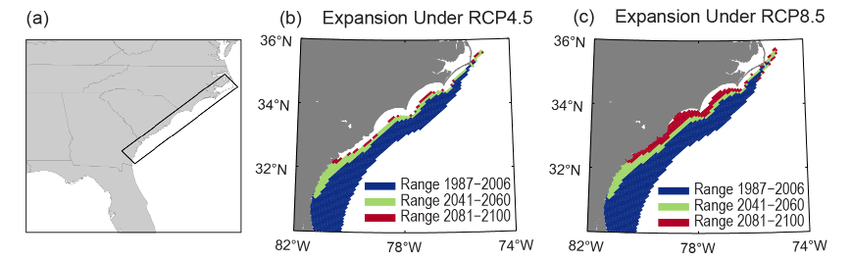
Fig. 7.4: Projected Range Expansion of Invasive Lionfish
Ch. 7 | Ecosystems, Ecosystem Services, and Biodiversity
Lionfish, native to the Pacific Ocean, are an invasive species in the Atlantic. Their range is projected to expand closer to (a) the U.S. Atlantic coastline as a result of climate change. The maps show projected range expansion of the invasive lionfish in the southeast United States by mid-century (green) and end of the century (red), based on (b) the lower and (c) higher scenarios (RCP4.5 and RCP8.5, respectively), as compared to their recently observed range (blue). The projected range shifts under a higher scenario (RCP8.5) represents a 45% increase over the current year-round range. Venomous lionfish are opportunistic, generalist predators that consume a wide variety of invertebrates and fishes and may compete with native predatory fishes. Expansion of their range has the potential to increase the number of stings of divers and fishers. Source: adapted from Grieve et al. 2016.⁷⁷
Notes:
77: Grieve, B.D., E.N. Curchitser, and R.R. Rykaczewski, 2016: Range expansion of the invasive lionfish in the Northwest Atlantic with climate change. Marine Ecology Progress Series, 546, 225-237. http://dx.doi.org/10.3354/meps11638

Slide 11
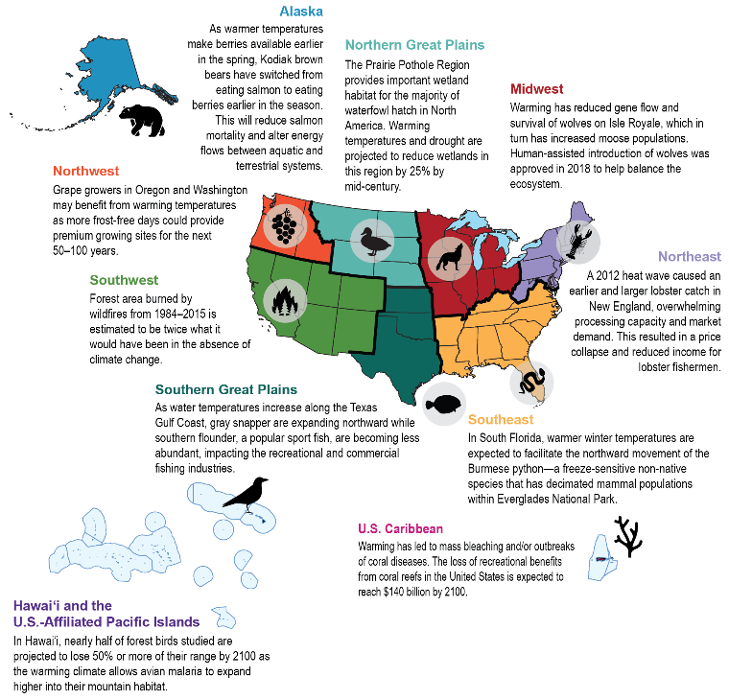
Fig. 7.5: Regional Ecosystems Impacts
Ch. 7 | Ecosystems, Ecosystem Services, and Biodiversity
This figure shows selected examples of impacts to biodiversity, ecosystems, and ecosystem services that are linked to climate change throughout the United States. See the online version at https://nca2018.globalchange.gov/chapter/7#fig-7-5 for more examples.

Slide 12
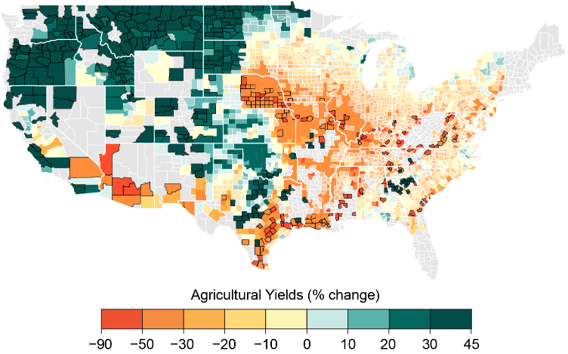
Fig. 7.6: Agricultural Productivity
Ch. 7 | Ecosystems, Ecosystem Services, and Biodiversity
The figure shows the projected percent change in the yield of corn, wheat, soybeans, and cotton during the period 2080–2099. Units represent average percent change in yields under the higher scenario (RCP8.5) as compared to a scenario of no additional climate change. Warmer colors (negative percent change) indicate large projected declines in yields; cooler colors (green) indicate moderate projected increases in yields. Source: adapted from Hsiang et al. 2017.¹⁷⁹ Data were not available for the U.S. Caribbean, Alaska, or Hawai‘i and U.S.-Affiliated Pacific Islands regions.
Notes:
179: Hsiang, S., R. Kopp, A. Jina, J. Rising, M. Delgado, S. Mohan, D.J. Rasmussen, R. Muir-Wood, P. Wilson, M. Oppenheimer, K. Larsen, and T. Houser, 2017: Estimating economic damage from climate change in the United States. Science, 356 (6345), 1362-1369. http://dx.doi.org/10.1126/science.aal4369

Slide 13
Ch. 7 | Ecosystems, Ecosystem Services, and Biodiversity
7
Chapter Author Team
Federal Coordinating Lead Authors
Shawn Carter, U.S. Geological Survey
Jay Peterson, National Oceanic and Atmospheric Administration
Chapter Leads
Douglas Lipton, National Oceanic and Atmospheric Administration
Madeleine A. Rubenstein, U.S. Geological Survey
Sarah R. Weiskopf, U.S. Geological Survey
Chapter Authors
Lisa Crozier, National Oceanic and Atmospheric Administration
Michael Fogarty, National Oceanic and Atmospheric Administration
Sarah Gaichas, National Oceanic and Atmospheric Administration
Kimberly J. W. Hyde, National Oceanic and Atmospheric Administration
Toni Lyn Morelli, U.S. Geological Survey
Jeffrey Morisette, U.S. Department of the Interior, National Invasive Species Council Secretariat
Hassan Moustahfid, National Oceanic and Atmospheric Administration
Roldan Muñoz, National Oceanic and Atmospheric Administration
Rajendra Poudel, National Oceanic and Atmospheric Administration
Michelle D. Staudinger, U.S. Geological Survey

Slide 14
Ch. 7 | Ecosystems, Ecosystem Services, and Biodiversity
7
Chapter Author Team
Chapter Authors (cont.)
Charles Stock, National Oceanic and Atmospheric Administration
Laura Thompson, U.S. Geological Survey
Robin Waples, National Oceanic and Atmospheric Administration
Jake F. Weltzin, U.S. Geological Survey
Review Editor
Gregg Marland, Appalachian State University

Slide 15
Ch. 7 | Ecosystems, Ecosystem Services, and Biodiversity
7
Acknowledgments
USGCRP Coordinators
Matthew Dzaugis, Program Coordinator
Allyza Lustig, Program Coordinator

Slide 16
Lipton, D., M.A. Rubenstein, S.R. Weiskopf, S. Carter, J. Peterson, L. Crozier, M. Fogarty, S. Gaichas, K.J.W. Hyde, T.L. Morelli, J. Morisette, H. Moustahfid, R. Muñoz, R. Poudel, M.D. Staudinger, C. Stock, L. Thompson, R. Waples, and J.F. Weltzin, 2018: Ecosystems, Ecosystem Services, and Biodiversity. In Impacts, Risks, and Adaptation in the United States: Fourth National Climate Assessment, Volume II [Reidmiller, D.R., C.W. Avery, D.R. Easterling, K.E. Kunkel, K.L.M. Lewis, T.K. Maycock, and B.C. Stewart (eds.)]. U.S. Global Change Research Program, Washington, DC, USA. doi: 10.7930/NCA4.2018.CH7
https://nca2018.globalchange.gov/chapter/ecosystems

