Slide 1
Chapter 5 | Land Cover and Land-Use Change

Slide 2
05 | Land Cover and Land-Use Change
5
Key Message #1
Land-Cover Changes Influence Weather and Climate
Changes in land cover continue to impact local- to global-scale weather and climate by altering the flow of energy, water, and greenhouse gases between the land and the atmosphere. Reforestation can foster localized cooling, while in urban areas, continued warming is expected to exacerbate urban heat island effects.

Slide 3
05 | Land Cover and Land-Use Change
5
Key Message #2
Climate Impacts on Land and Ecosystems
Climate change affects land use and ecosystems. Climate change is expected to directly and indirectly impact land use and cover by altering disturbance patterns, species distributions, and the suitability of land for specific uses. The composition of the natural and human landscapes, and how society uses the land, affects the ability of the Nation’s ecosystems to provide essential goods and services.

Slide 4
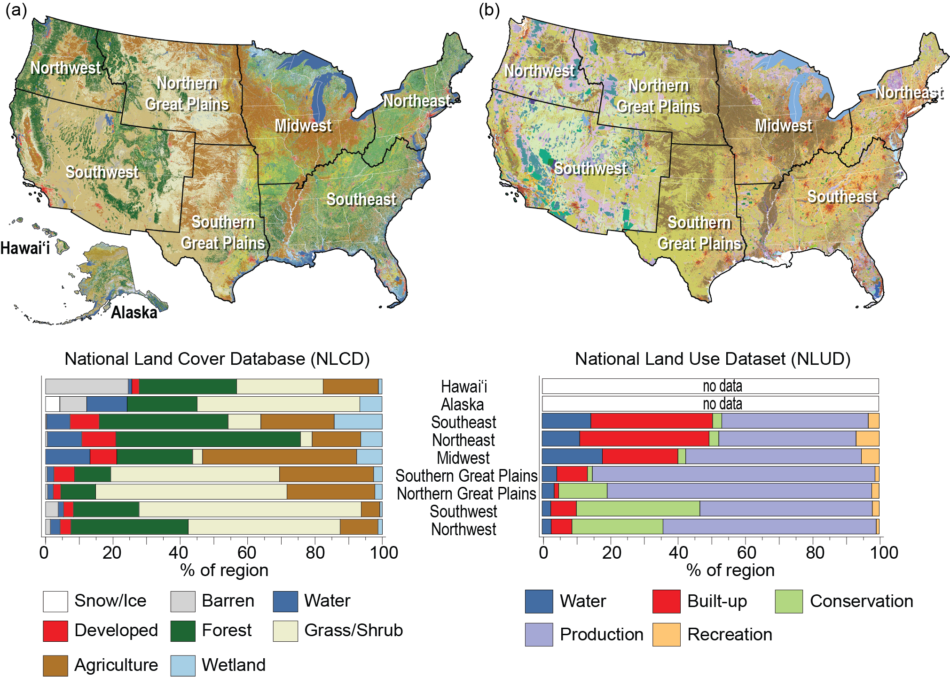
Fig. 5.1: Land-Use and Land-Cover Composition
05 | Land Cover and Land-Use Change
The composition of land use and land cover (LULC) is highly variable across the United States, owing in part to the natural environmental settings of each region. Forests dominate much of the vegetated areas of the eastern United States, while much of the Great Plains and Southwest are dominated by grasses and shrubs. Characterizing the composition of LULC also depends on the type of classification system used. This figure shows two different classification systems used to represent different components of land use and land cover: (a) the National Land Cover Database (NLCD),³ which is derived from the classification of satellite images and represents the physical features on the ground, such as land that is covered by trees (forest cover) or impervious surfaces (developed cover); and (b) the National Land Use Dataset (NLUD),⁵⁸ which divides the land into 79 land-use categories that can be aggregated into five major use categories, including lands used for conservation, production of goods and services, and recreation. Data are unavailable for both the U.S. Caribbean region and the U.S.-Affiliated Pacific Islands in the NLCD and the NLUD. Source: USGS.
Notes:
3: Homer, C.G., J.A. Dewitz, L. Yang, S. Jin, P. Danielson, G. Xian, J. Coulston, N.D. Herold, J. Wickham, and K. Megown, 2015: Completion of the 2011 National Land Cover Database for the conterminous United States—Representing a decade of land cover change information. Photogrammetric Engineering & Remote Sensing, 81 (5), 345-354. http://dx.doi.org/10.14358/PERS.81.5.345
58: Theobald, D.M., 2014: Development and applications of a comprehensive land use classification and map for the US. PLOS ONE, 9 (4), e94628. http://dx.doi.org/10.1371/journal.pone.0094628

Slide 5
Table 5.1: Estimates of Land-Use Area (Square Miles) by NCA Region
05 | Land Cover and Land-Use Change
NCA Region | Croplands | Forestlands | Grasslands | Other Lands | Settlements | Wetlands
Alaska | 111 | 133,438 | 305,659 | 76,388 | 558 | 64,336
Hawai'i | 173 | 2,501 | 1,997 | 1,283 | 438 | 51
Midwest | 212,994 | 142,314 | 43,753 | 4,140 | 36,638 | 18,867
Northern Great Plains | 136,089 | 62,829 | 248,678 | 4,473 | 8,216 | 9,765
Northeast | 24,490 | 131,383 | 11,649 | 2,929 | 24,856 | 12,521
Northwest | 28,076 | 114,263 | 89,963 | 3,853 | 7,784 | 5,573
Southern Great Plains | 103,698 | 103,325 | 182,216 | 2,547 | 19,878 | 7,790
Southeast | 84,137 | 301,616 | 58,442 | 3,610 | 45,799 | 34,852
Southwest | 39,782 | 174,669 | 416,464 | 30,324 | 22,311 | 10,237
Total | 629,550 | 1,166,338 | 1,358,821 | 129,547 | 166,478 | 163,992
Definitions of land use and land cover vary among agencies and entities collecting those data. This may lead to fundamental differences in these estimates that must be considered when comparing estimates of cover and use. For the purposes of this report, land cover is defined as the physical characteristics of land, such as trees or pavement, and land use is characterized by human management and activities on land, such as mining or recreation. The land-use area estimates in this table and throughout this chapter were obtained from the U.S. Forest Service’s Forest Inventory and Analysis (FIA) Program and the National Resources Conservation Service’s (NRCS) Natural Resources Inventory (NRI) data, when available for an area, because the surveys contain additional information on management, site conditions, crop types, biometric measurements, and other data that are needed to estimate carbon stock changes and nitrous oxide and methane emissions on those lands. If NRI and FIA data are not available for an area, however, then the NLCD product is used to represent the land use. Since all three data sources were used in the land representation analysis within the National Inventory Report, we used land-use estimates from the U.S. Environmental Protection Agency’s annual greenhouse gas inventory report.⁶¹ Data are unavailable for both the U.S. Caribbean region and the U.S.-Affiliated Pacific Islands in the NRI and FIA datasets.
Notes:
61: EPA, 2017: Inventory of U.S. Greenhouse Gas Emissions and Sinks: 1990-2015. EPA 430-P-17-001. U.S. Environmental Protection Agency, Washington, DC, 633 pp. https://www.epa.gov/sites/production/files/2017-02/documents/2017_complete_report.pdf

Slide 6
Fig. 5.2: Changes in Land Cover by Region
05 | Land Cover and Land-Use Change
The figure shows the net change in land cover by class in square miles, from 1973 to 2011. Land-cover change has been highly dynamic over space, time, and sector, in response to a range of driving forces. Net change in land cover reveals the trajectory of a class over time. A dramatic example illustrated here is the large decline in agricultural lands in the two Great Plains regions beginning in the mid-1980s, which resulted in large part from the establishment of the Conservation Reserve Program. Over the same period, agriculture also declined in the Southwest region; however, the net decline was largely attributable to prolonged drought conditions, as opposed to changes in federal policy. Data for the period 1973–2000 are from Sleeter et al. (2013)² while data from 2001–2011 are from the National Land Cover Database (NLCD.³ Note: the two disturbance categories used for the 1973–2000 data were not included in the NLCD data for 2001–2011 and largely represent conversions associated with harvest activities (mechanical disturbance) and wildfire (nonmechanical disturbance). Comparable data are unavailable for the U.S. Caribbean, Alaska, and Hawai‘i & U.S.-Affiliated Pacific Islands regions, precluding their representation in this figure. Source: USGS.
Notes:
2: Sleeter, B.M., T.L. Sohl, T.R. Loveland, R.F. Auch, W. Acevedo, M.A. Drummond, K.L. Sayler, and S.V. Stehman, 2013: Land-cover change in the conterminous United States from 1973 to 2000. Global Environmental Change, 23 (4), 733-748. http://dx.doi.org/10.1016/j.gloenvcha.2013.03.006
3: Homer, C.G., J.A. Dewitz, L. Yang, S. Jin, P. Danielson, G. Xian, J. Coulston, N.D. Herold, J. Wickham, and K. Megown, 2015: Completion of the 2011 National Land Cover Database for the conterminous United States—Representing a decade of land cover change information. Photogrammetric Engineering & Remote Sensing, 81 (5), 345-354. http://dx.doi.org/10.14358/PERS.81.5.345

Slide 7
Fig. 5.3: Development in the Houston Area
05 | Land Cover and Land-Use Change
The figure shows the development-related changes surrounding Houston, Texas, from 1996 to 2010, as mapped by NOAA’s Coastal Change and Analysis Program (C-CAP). Areas of change between 1996 and 2010 are shown in black.⁶³ These changes can have numerous impacts on the environment and populations, ranging from increased urban heat island effects and storm water runoff (the latter of which can increase flooding and produce water quality impacts), to decreases in natural cover. Source: USGS.
Notes:
63: Office for Coastal Management, 2018: C-CAP FTP Tool: An interface for downloading land cover data. NOAA National Ocean Service, Silver Spring, MD. https://www.coast.noaa.gov/ccapftp

Slide 8
05 | Land Cover and Land-Use Change
5
Chapter Author Team
Federal Coordinating Lead Author
Thomas Loveland, U.S. Geological Survey
Chapter Lead
Benjamin M. Sleeter, U.S. Geological Survey
Chapter Authors
James Wickham, U.S. Environmental Protection Agency
Grant Domke, U.S. Forest Service
Nate Herold, National Oceanic and Atmospheric Administration
Nathan Wood, U.S. Geological Survey
Review Editor
Georgine Yorgey, Washington State University

Slide 9
05 | Land Cover and Land-Use Change
5
Acknowledgments
Technical Contributors
Tamara S. Wilson, U.S. Geological Survey
Jason Sherba, U.S. Geological Survey
USGCRP Coordinators
Susan Aragon-Long, Senior Scientist
Christopher W. Avery, Senior Manager

Slide 10
Sleeter, B.M., T. Loveland, G. Domke, N. Herold, J. Wickham, and N. Wood, 2018: Land Cover and Land-Use Change. In Impacts, Risks, and Adaptation in the United States: Fourth National Climate Assessment, Volume II [Reidmiller, D.R., C.W. Avery, D.R. Easterling, K.E. Kunkel, K.L.M. Lewis, T.K. Maycock, and B.C. Stewart (eds.)]. U.S. Global Change Research Program, Washington, DC, USA. doi: 10.7930/NCA4.2018.CH5
https://nca2018.globalchange.gov/chapter/land-changes

