Slide 1
Chapter 18 | Northeast

Slide 2
Ch. 18 | Northeast
18
Key Message #1
Changing Seasons Affect Rural Ecosystems,
Environments, and Economies
The seasonality of the Northeast is central to the region’s sense of place and is an important driver of rural economies. Less distinct seasons with milder winter and earlier spring conditions are already altering ecosystems and environments in ways that adversely impact tourism, farming, and forestry. The region’s rural industries and livelihoods are at risk from further changes to forests, wildlife, snowpack, and streamflow.

Slide 3
Ch. 18 | Northeast
18
Key Message #2
Changing Coastal and Ocean Habitats, Ecosystem
Services, and Livelihoods
The Northeast’s coast and ocean support commerce, tourism, and recreation that are important to the region’s economy and way of life. Warmer ocean temperatures, sea level rise, and ocean acidification threaten these services. The adaptive capacity of marine ecosystems and coastal communities will influence ecological and socioeconomic outcomes as climate risks increase.

Slide 4
Ch. 18 | Northeast
18
Key Message #3
Maintaining Urban Areas and Communities and
Their Interconnectedness
The Northeast’s urban centers and their interconnections are regional and national hubs for cultural and economic activity. Major negative impacts on critical infrastructure, urban economies, and nationally significant historic sites are already occurring and will become more common with a changing climate.

Slide 5
Ch. 18 | Northeast
18
Key Message #4
Threats to Human Health
Changing climate threatens the health and well-being of people in the Northeast through more extreme weather, warmer temperatures, degradation of air and water quality, and sea level rise. These environmental changes are expected to lead to health-related impacts and costs, including additional deaths, emergency room visits and hospitalizations, and a lower quality of life. Health impacts are expected to vary by location, age, current health, and other characteristics of individuals and communities.

Slide 6
Ch. 18 | Northeast
18
Key Message #5
Adaptation to Climate Change Is Underway
Communities in the Northeast are proactively planning and implementing actions to reduce risks posed by climate change. Using decision support tools to develop and apply adaptation strategies informs both the value of adopting solutions and the remaining challenges. Experience since the last assessment provides a foundation to advance future adaptation efforts.

Slide 7
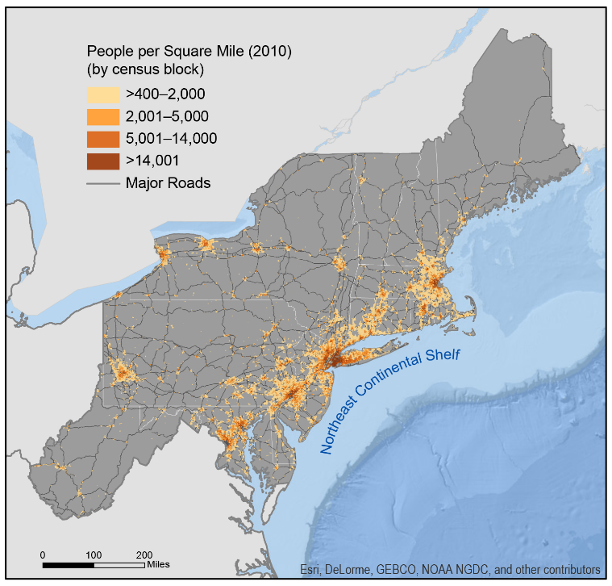
Fig. 18.1: Population Density
Ch. 18 | Northeast
A map showing primary roads and population density highlights the diverse characteristics of the region in terms of settlement patterns, interconnections among population centers of varying sizes, and variability in relief across the ocean shelf. Sources: U.S. Department of Transportation, U.S. Geological Survey, and ERT, Inc.

Slide 8
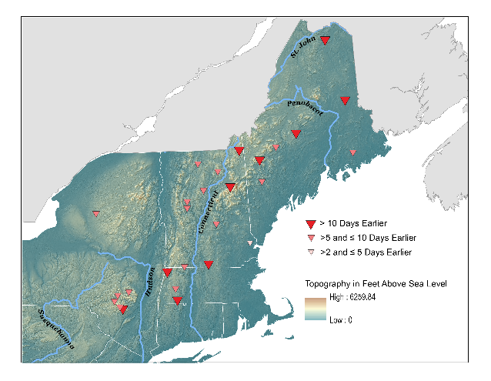
Fig. 18.2: Historical Changes in the Timing of Snowmelt-Related Streamflow
Ch. 18 | Northeast
This map of part of the Northeast region shows consistently earlier snowmelt-related streamflow timing for rivers from 1960 to 2014. Each symbol represents the change for an individual river over the entire period. Changes in the timing of snowmelt potentially interfere with the reproduction of many aquatic species¹¹³ and impact water-supply reservoir management because of higher winter flows and lower spring flows.¹¹⁴ The timing of snowmelt-related streamflow in the Northeast is sensitive to small changes in air temperature. The average winter–spring air temperature increase of 1.67°F in the Northeast from 1940 to 2014 is thought to be the cause of average earlier streamflow timing of 7.7 days.¹¹² The timing of snowmelt-related streamflow is a valuable long-term indicator of winter–spring changes in the Northeast. Source: adapted from Dudley et al. 2017;¹¹² Digital Elevation Model CGIAR–CSI (CGIAR Consortium for Spatial Information). Reprinted with permission from Elsevier.
Notes:
112: Dudley, R.W., G.A. Hodgkins, M.R. McHale, M.J. Kolian, and B. Renard, 2017: Trends in snowmelt-related streamflow timing in the conterminous United States. Journal of Hydrology, 547, 208-221. http://dx.doi.org/10.1016/j.jhydrol.2017.01.051
113: Poff, N.L.R., M.M. Brinson, and J.W. Day, 2002: Aquatic Ecosystems & Global Climate Change: Potential Impacts on Inland Freshwater and Coastal Wetland Ecosystems in the United States. Pew Center on Global Climate Change Arlington, Virginia, 56 pp. https://www.pewtrusts.org/-/media/legacy/uploadedfiles/wwwpewtrustsorg/reports/protecting_ocean_life/envclimateaquaticecosystemspdf.pdf
114: Hay, L.E., S.L. Markstrom, and C. Ward-Garrison, 2011: Watershed-scale response to climate change through the twenty-first century for selected basins across the United States. Earth Interactions, 15 (17), 1-37. http://dx.doi.org/10.1175/2010ei370.1

Slide 9
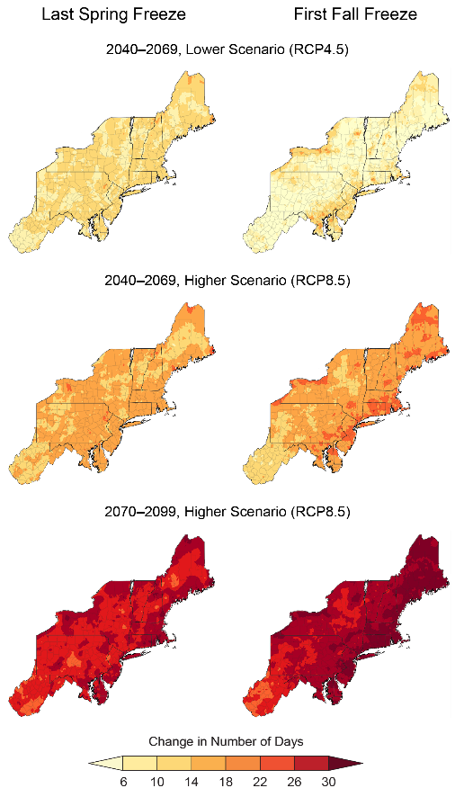
Fig. 18.3: Lengthening of the Freeze-Free Period
Ch. 18 | Northeast
These maps show projected shifts in the date of the last spring freeze (left column) and the date of the first fall freeze (right column) for the middle of the century (as compared to 1979–2008) under the lower scenario (RCP4.5; top row) and the higher scenario (RCP8.5; middle row). The bottom row shows the shift in these dates for the end of the century under the higher scenario. By the middle of the century, the freeze-free period across much of the Northeast is expected to lengthen by as much as two weeks under the lower scenario and by two to three weeks under the higher scenario. By the end of the century, the freeze-free period is expected to increase by at least three weeks over most of the region. Source: adapted from Wolfe et al. 2018.³⁵
Notes:
35: Wolfe, D.W., A.T. DeGaetano, G.M. Peck, M. Carey, L.H. Ziska, J. Lea-Cox, A.R. Kemanian, M.P. Hoffmann, and D.Y. Hollinger, 2018: Unique challenges and opportunities for northeastern US crop production in a changing climate. Climatic Change, 146 (1-2), 231-245. http://dx.doi.org/10.1007/s10584-017-2109-7

Slide 10
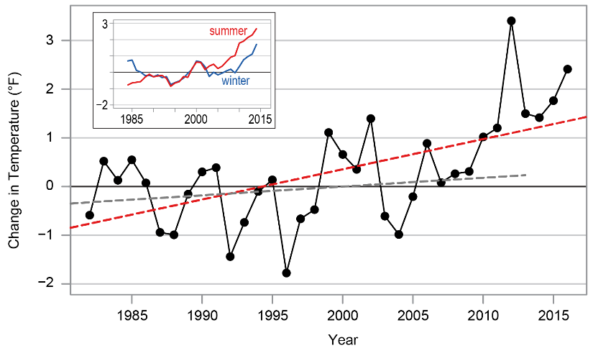
Fig. 18.4: Change in Sea Surface Temperature on the Northeast Continental Shelf
Ch. 18 | Northeast
The figure shows annual average sea surface temperature (SST) differences from the 1982–2011 average (black dots and line). Over the period 1982–2016, sea surface temperature on the Northeast Continental Shelf has warmed at a rate of 0.06°F (0.033°C) per year (red dashed line). This rate is three times faster than the 1982–2013 global SST warming rate of 0.018°F (0.01°C) per year (gray dotted line).³⁹ The inset shows Northeast Continental Shelf seasonal SST differences from the 1982–2011 average as five-year rolling means for summer (July, August, September; red line) and winter (January, February, March; blue line). These seasons are centered on the warmest (summer) and coolest (winter) months for Northeast Shelf SSTs. Both seasons have warmed over the time period, but the summer warming rate has been stronger. Source: Gulf of Maine Research Institute.
Notes:
39: Pershing, A.J., M.A. Alexander, C.M. Hernandez, L.A. Kerr, A. Le Bris, K.E. Mills, J.A. Nye, N.R. Record, H.A. Scannell, J.D. Scott, G.D. Sherwood, and A.C. Thomas, 2015: Slow adaptation in the face of rapid warming leads to collapse of the Gulf of Maine cod fishery. Science, 350 (6262), 809-812. http://dx.doi.org/10.1126/science.aac9819

Slide 11
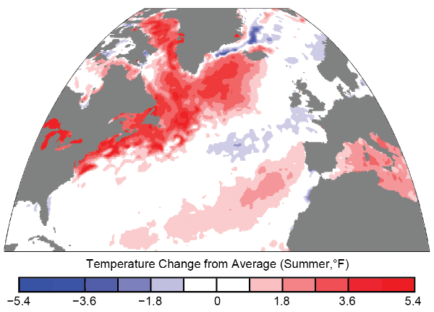
Fig. 18.5: Ocean Heat Wave of 2012
Ch. 18 | Northeast
The map shows the difference between sea surface temperatures (SST) for June–August 2012 in the Northwest Atlantic and the average values for those months in 1982–2011.¹⁵⁵ While ocean temperatures during 2012 were exceptionally high compared to the current climate, they were within the range of end-of-century temperatures projected for the region under the higher scenario (RCP8.5). This heat wave affected the Northeast Continental Shelf ecosystem and fisheries, and similar extreme events are expected to become more common in the future (Ch. 9: Oceans). Source: adapted from Mills et al. 2013.¹⁵⁵ Reprinted with permission from Elsevier.
Notes:
155: Mills, K.E., A.J. Pershing, C.J. Brown, Y. Chen, F.-S. Chiang, D.S. Holland, S. Lehuta, J.A. Nye, J.C. Sun, A.C. Thomas, and R.A. Wahle, 2013: Fisheries management in a changing climate: Lessons from the 2012 ocean heat wave in the northwest Atlantic. Oceanography, 26 (2), 191–195. http://dx.doi.org/10.5670/oceanog.2013.27

Slide 12
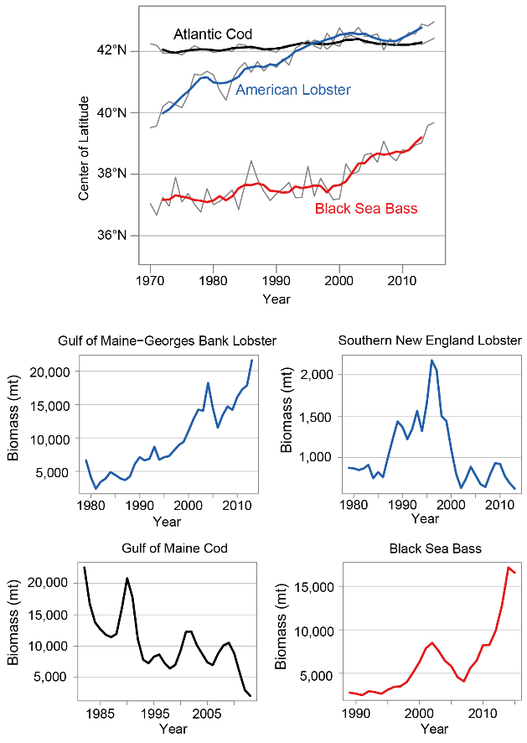
Fig. 18.6: Changes in Distribution and Abundance of Marine Species
Ch. 18 | Northeast
The figure shows changes over time in geographic distribution (top panel) and biomass (four bottom panels) for various marine species along the Northeast Shelf. As waters in the region have warmed, the spatial distributions of many fish species have been shifting northward, while population trends of several marine species show more variability over time. The top panel shows shifts in spatial distribution over time for select fish species, based on their latitudinal centers of biomass. The four panels on the bottom show biomass estimates for the same marine resource stocks. Gulf of Maine cod, a coldwater species, has not shifted in location but has declined in biomass, while black sea bass (a warmwater species) has moved northward and increased in biomass as waters have warmed. The lobster distribution shift reflects declines in productivity of the southern stock and increasing biomass of the northern stock. Sources: (black sea bass) adapted from Northeast Fisheries Science Center 2017;²⁰⁴ (all others) Gulf of Maine Research Institute.
Notes:
204: Northeast Fisheries Science Center (NEFSC), 2017: 62nd Northeast Regional Stock Assessment Workshop (62nd SAW): Assessment Report. NEFSC Reference Document 17-03. NOAA's National Marine Fisheries Service, Woods Hole, MA, 822 pp. http://dx.doi.org/10.7289/V5/RD-NEFSC-17-03

Slide 13
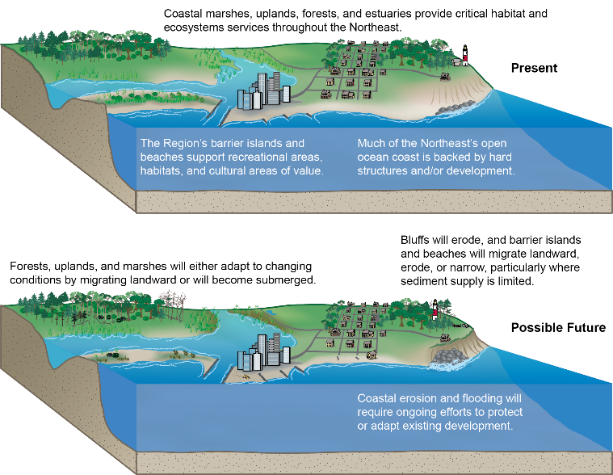
Fig 18.7: Coastal Impacts of Climate Change
Ch. 18 | Northeast
(top) The northeastern coastal landscape is composed of uplands and forested areas, wetlands and estuarine systems, mainland and barrier beaches, bluffs, headlands, and rocky shores, as well as developed areas, all of which provide a variety of important services to people and species. (bottom) Future impacts from intense storm activity and sea level rise will vary across the landscape, requiring a variety of adaptation strategies if people, habitats, traditions, and livelihoods are to be protected. Source: U.S. Geological Survey.

Slide 14
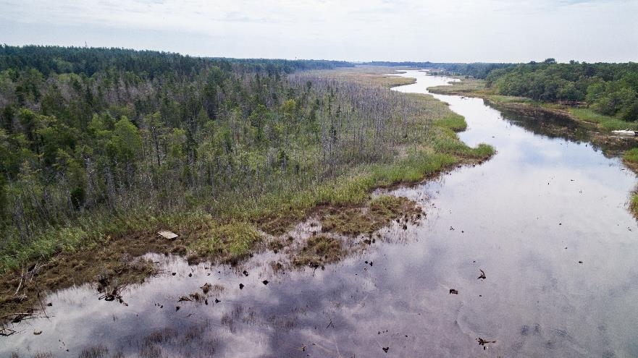
Fig 18.8: Wetland Encroachment on Forested Areas
Ch. 18 | Northeast
Atlantic white cedars dying near the banks of the Bass River in New Jersey show wetland encroachment on forested areas. Photo credit: Ted Blanco/Climate Central.

Slide 15
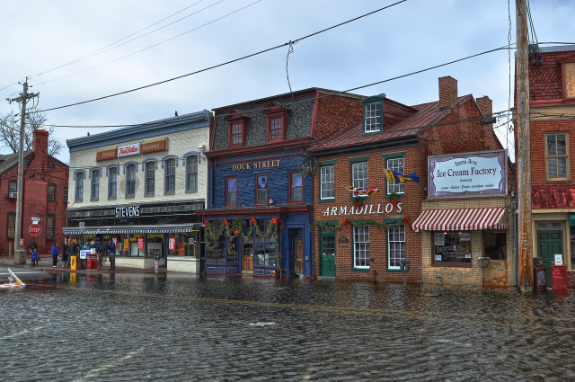
Fig 18.9: King Tide Flooding in Annapolis, Maryland
Ch. 18 | Northeast
The photo shows King Tide flooding on Dock Street in Annapolis, Maryland, on December 21, 2012. Photo credit: Amy McGovern (CC BY 2.0).

Slide 16
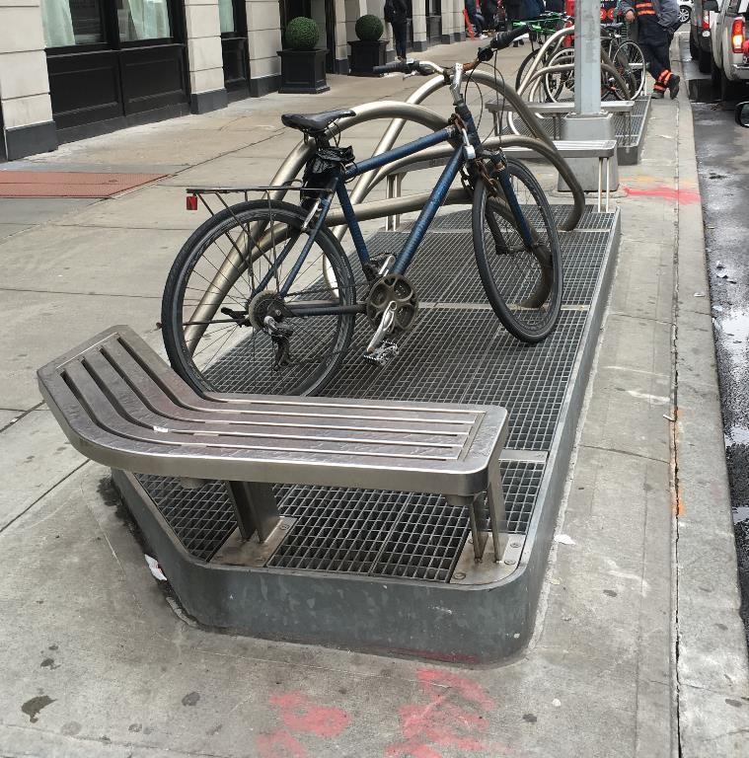
Fig 18.10: Subway Air Vent Flood Protection
Ch. 18 | Northeast
The photo shows a subway air vent with a multiuse raised flood protection grate that was installed as part of the post–Superstorm Sandy coastal resilience efforts on West Broadway in lower Manhattan, New York City. Photo credit: William Solecki.

Slide 17
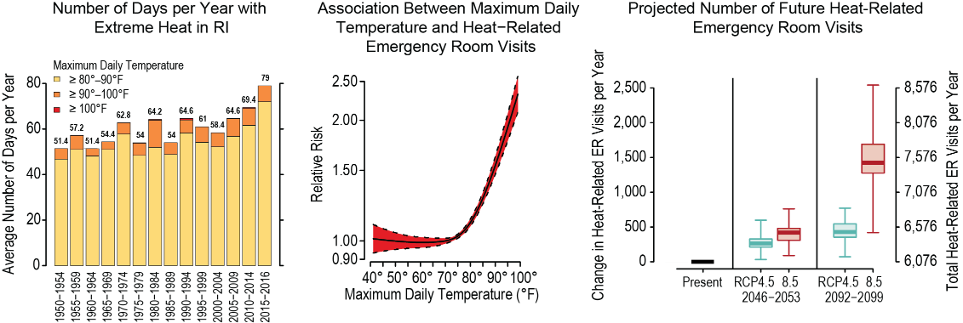
Fig. 18.11: Observed and Projected Impacts of Excess Heat on Emergency Room Visits in Rhode Island
Ch. 18 | Northeast
This figure shows the observed and projected impacts of excess heat on emergency room visits in Rhode Island. (left) In Rhode Island, maximum daily temperatures in the summer have trended upwards over the last 60 years, such that residents experienced about three more weeks of health-threatening hot weather over 2015–2016 than in the 1950s. (middle) A recent study looking at visits to hospital emergency rooms (ERs) found that the incidence rate of heat-related ER visits rose sharply as maximum daily temperatures climbed above 80°F. (right) The study estimates that with continued climate change, Rhode Islanders could experience an additional 400 (6.8% more) heat-related ER visits each year by 2050 and up to an additional 1,500 (24.4% more) such visits each year by 2095 under the higher scenario (RCP8.5). About 1,000 fewer annual heat-related ER visits are projected for the end of the century under the lower scenario (RCP4.5) compared to the higher scenario (RCP8.5), reflecting the estimated health benefits of adhering to a lower greenhouse gas emissions scenario. Sources: (left) Brown University; (middle, right) adapted from Kingsley et al. 2016.²⁶ Reproduced from Environmental Health Perspectives.
Notes:
26: Kingsley, S.L., M.N. Eliot, J. Gold, R.R. Vanderslice, and G.A. Wellenius, 2016: Current and projected heat-related morbidity and mortality in Rhode Island. Environmental Health Perspectives, 124 (4), 460-467. http://dx.doi.org/10.1289/ehp.1408826

Slide 18
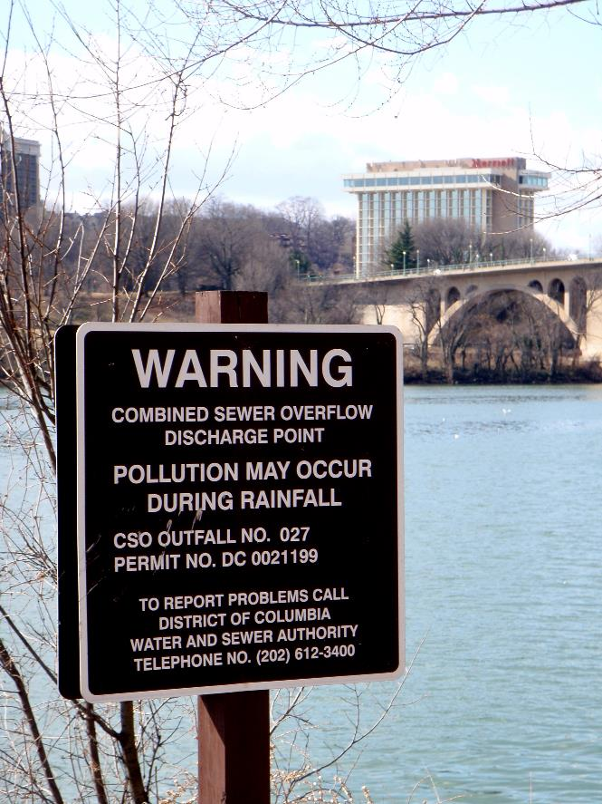
Fig. 18.12: District of Columbia Water and Sewer Authority’s Clean Rivers Project
Ch. 18 | Northeast
The District of Columbia Water and Sewer Authority’s Clean Rivers Project³⁴² aims to reduce combined sewer overflows into area waterways. The Clean Rivers Project is expected to reduce overflows annually by 96% throughout the system and by 98% for the Anacostia River. In addition, the project is expected to reduce the chance of flooding in the areas it serves from approximately 50% to 7% in any given year and reduce nitrogen discharged to the Chesapeake Bay by approximately 1 million pounds per year. Photo credit: Daniel Lobo (CC BY 2.0).
Notes:
342: DC Water, 2018: Clean Rivers Project [web site]. DC Water, Washington, DC. https://www.dcwater.com/clean-rivers-project

Slide 19

Fig. 18.13: Impacts of Flooding in West Virginia
Ch. 18 | Northeast
A Red Cross volunteer talks with a community resident after the 2016 West Virginia floods. Additionally, local medical professionals mobilized to staff temporary clinical sites. Photo credit: National Guard Bureau Public Affairs.

Slide 20
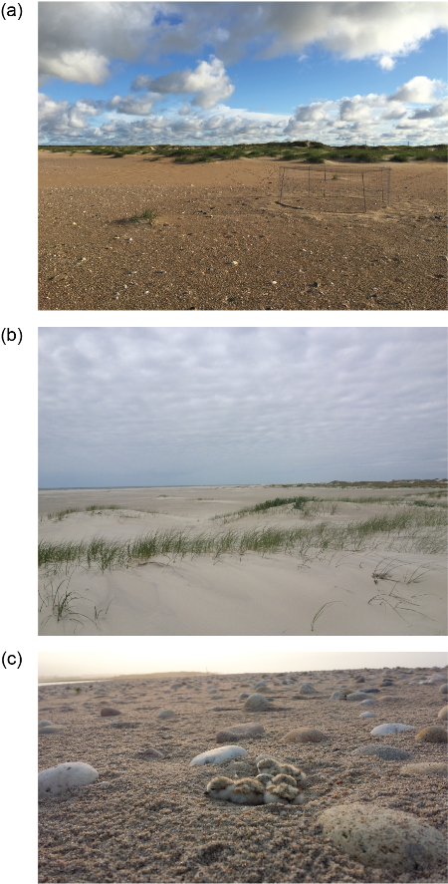
Fig 18.14: Plover Case Study
Ch. 18 | Northeast
(a, b) These photographs show suitable piping plover habitat for (c) rearing chicks along the U.S. Atlantic coast. Photo credits: (a, b) Sara Zeigler, U.S. Geological Survey; (c) Josh Seibel, U.S. Fish and Wildlife Service.

Slide 21
Ch. 18 | Northeast
18
Chapter Author Team
Federal Coordinating Lead Author
Ellen L. Mecray, National Oceanic and Atmospheric Administration
Chapter Lead
Lesley-Ann L. Dupigny-Giroux, University of Vermont
Chapter Authors
Mary D. Lemcke-Stampone, University of New Hampshire
Glenn A. Hodgkins, U.S. Geological Survey
Erika E. Lentz, U.S. Geological Survey
Katherine E. Mills, Gulf of Maine Research Institute
Erin D. Lane, U.S. Department of Agriculture
Rawlings Miller, WSP (formerly U.S. Department of Transportation Volpe Center)
David Y. Hollinger, U.S. Department of Agriculture
William D. Solecki, City University of New York–Hunter College
Gregory A. Wellenius, Brown University
Perry E. Sheffield, Icahn School of Medicine at Mount Sinai
Anthony B. MacDonald, Monmouth University
Christopher Caldwell, College of Menominee Nation
Review Editor
Jayne F. Knott, University of New Hampshire

Slide 22
Ch. 18 | Northeast
18
Acknowledgments
Technical Contributors
Zoe P. Johnson, U.S. Department of Defense,
Naval Facilities Engineering Command
(formerly NOAA Chesapeake Bay Office)
Amanda Babson, U.S. National Park Service
Elizabeth Pendleton, U.S. Geological Survey
Benjamin T. Gutierrez, U.S. Geological Survey
Joseph Salisbury, University of New Hampshire
Andrew Sven McCall Jr., University of Vermont
E. Robert Thieler, U.S. Geological Survey
Sara L. Zeigler, U.S. Geological Survey
USGCRP Coordinators
Christopher W. Avery, Senior Manager
Matthew Dzaugis, Program Coordinator
Allyza Lustig, Program Coordinator

Slide 23
Dupigny-Giroux, L.A., E.L. Mecray, M.D. Lemcke-Stampone, G.A. Hodgkins, E.E. Lentz, K.E. Mills, E.D. Lane, R. Miller, D.Y. Hollinger, W.D. Solecki, G.A. Wellenius, P.E. Sheffield, A.B. MacDonald, and C. Caldwell, 2018: Northeast. In Impacts, Risks, and Adaptation in the United States: Fourth National Climate Assessment, Volume II [Reidmiller, D.R., C.W. Avery, D.R. Easterling, K.E. Kunkel, K.L.M. Lewis, T.K. Maycock, and B.C. Stewart (eds.)]. U.S. Global Change Research Program, Washington, DC, USA. doi: 10.7930/NCA4.2018.CH18
https://nca2018.globalchange.gov/chapter/northeast

