Slide 1
Chapter 10 | Agriculture and Rural Communities

Slide 2
Ch. 10 | Agriculture and Rural Communities
10
Key Message #1
Reduced Agricultural Productivity
Food and forage production will decline in regions experiencing increased frequency and duration of drought. Shifting precipitation patterns, when associated with high temperatures, will intensify wildfires that reduce forage on rangelands, accelerate the depletion of water supplies for irrigation, and expand the distribution and incidence of pests and diseases for crops and livestock. Modern breeding approaches and the use of novel genes from crop wild relatives are being employed to develop higher-yielding, stress-tolerant crops.

Slide 3
Ch. 10 | Agriculture and Rural Communities
10
Key Message #2
Degradation of Soil and Water Resources
The degradation of critical soil and water resources will expand as extreme precipitation events increase across our agricultural landscape. Sustainable crop production is threatened by excessive runoff, leaching, and flooding, which results in soil erosion, degraded water quality in lakes and streams, and damage to rural community infrastructure. Management practices to restore soil structure and the hydrologic function of landscapes are essential for improving resilience to these challenges.

Slide 4
Ch. 10 | Agriculture and Rural Communities
10
Key Message #3
Health Challenges to Rural Populations and Livestock
Challenges to human and livestock health are growing due to the increased frequency and intensity of high temperature extremes. Extreme heat conditions contribute to heat exhaustion, heatstroke, and heart attacks in humans. Heat stress in livestock results in large economic losses for producers. Expanded health services in rural areas, heat-tolerant livestock, and improved design of confined animal housing are all important advances to minimize these challenges.

Slide 5
Ch. 10 | Agriculture and Rural Communities
10
Key Message #4
Vulnerability and Adaptive Capacity of Rural Communities
Residents in rural communities often have limited capacity to respond to climate change impacts, due to poverty and limitations in community resources. Communication, transportation, water, and sanitary infrastructure are vulnerable to disruption from climate stressors. Achieving social resilience to these challenges would require increases in local capacity to make adaptive improvements in shared community resources.

Slide 6
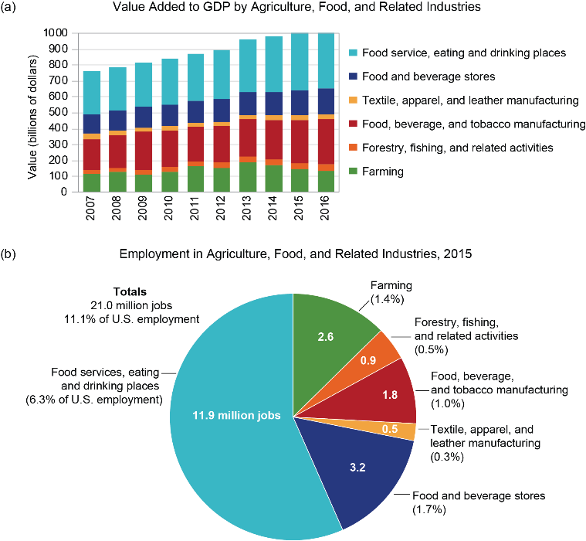
Fig. 10.1: Agricultural Jobs and Revenue
Ch. 10 | Agriculture and Rural Communities
The figure shows (a) the contribution of agriculture and related sectors to the U.S. economy and (b) employment figures in agriculture and related sectors (as of 2015). Agriculture and other food-related value-added sectors account for 21 million full- and part-time jobs and contribute about $1 trillion annually to the United States economy. Source: adapted from Kassel et al. 2017.¹
Notes:
1: Kassel, K., A. Melton, and R.M. Morrison, 2017: Selected Charts from Ag and Food Statistics: Charting the Essentials. AP-078. USDA Economic Research Service, Washington, DC, 27 pp. https://www.ers.usda.gov/webdocs/publications/85463/ap-078.pdf?v=43025

Slide 7
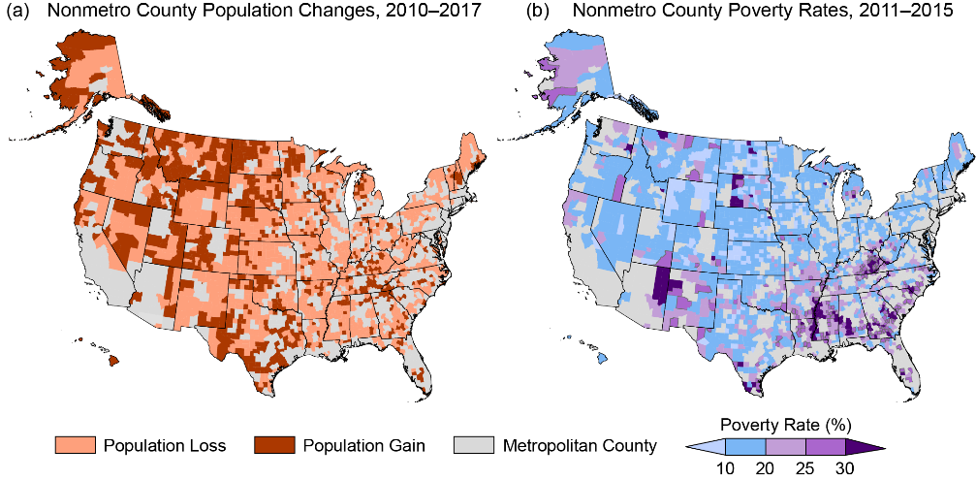
Fig. 10.2: Population Changes and Poverty Rates in Rural Counties
Ch. 10 | Agriculture and Rural Communities
The figure shows county-level (a) population changes for 2010–2017 and (b) poverty rates for 2011–2015 in rural U.S. communities. Rural populations are migrating to urban regions due to relatively slow employment growth and high rates of poverty. Data for the U.S. Caribbean region were not available at the time of publication. Sources: (a) adapted from ERS 2018²; (b) redrawn from ERS 2017.³
Notes:
2: ERS, 2018: Nonmetro Population Change, 2010- 17 [chart]. USDA Economic Research Service (ERS), Washington, DC. https://www.ers.usda.gov/data-products/chart-gallery/gallery/chart-detail/?chartId=60121
3: ERS, 2017: Nonmetro County Poverty Rates, 2011-2015 Average [chart]. USDA Economic Research Service (ERS), Washington, DC. https://www.ers.usda.gov/data-products/chart-gallery/gallery/chart-detail/?chartId=82280

Slide 8
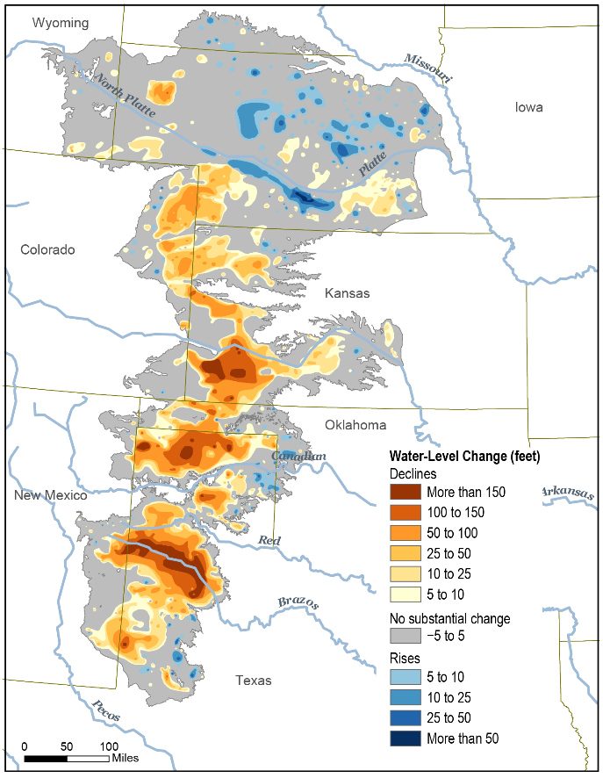
Fig. 10.3: Changes in the Ogallala Aquifer
Ch. 10 | Agriculture and Rural Communities
The figure shows changes in groundwater levels in the Ogallala Aquifer from predevelopment to 2015. Source: adapted from McGuire 2017.¹⁶³
Notes:
163: McGuire, V.L., 2017: Water-Level and Recoverable Water in Storage Changes, High Plains Aquifer, Predevelopment to 2015 and 2013–15. 2017-5040, Scientific Investigations Report 2017-5040. U. S. Geological Survey, Reston, VA, 24 pp. http://dx.doi.org/10.3133/sir20175040

Slide 9
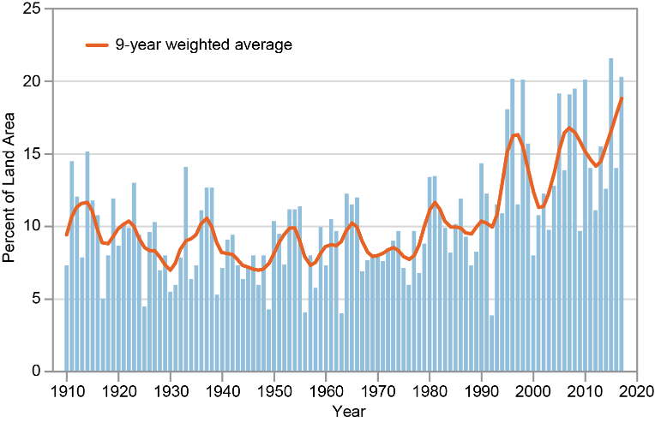
Fig. 10.4: Land Area and Extreme Precipitation
Ch. 10 | Agriculture and Rural Communities
The figure shows the percent of land area in the contiguous 48 states experiencing extreme one-day precipitation events between 1910 and 2017. These extreme events pose erosion and water quality risks that have increased in recent decades. The bars represent individual years, and the orange line is a nine-year weighted average. Source: adapted from EPA 2016.¹⁷¹
Notes:
171: EPA, 2016: Climate Change Indicators: Heavy Precipitation. U.S. Environmental Protection Agency (EPA). https://www.epa.gov/climate-indicators/climate-change-indicators-heavy-precipitation

Slide 10
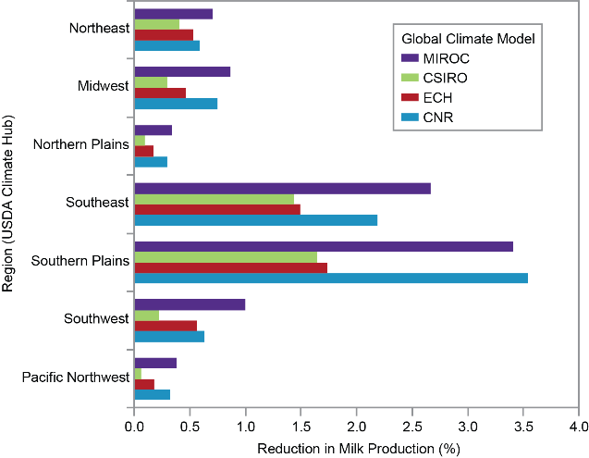
Fig. 10.5: Projected Reduction in Milk Production
Ch. 10 | Agriculture and Rural Communities
The figure shows the predicted reduction in annual milk production in 2030 compared to 2010 in climate change induced heat stress. The regions are grouped according to USDA regional Climate Hubs (https://www.climatehubs.oce.usda.gov), and the colored bars show the four global climate models used. Source: redrawn from Key et al. 2014.⁸³
Notes:
83: Key, N., S. Sneeringer, and D. Marquardt, 2014: Climate Change, Heat Stress, and U.S. Dairy Production. Economic Research Report No. ERR- 175. USDA Economic Research Service, Washington, DC, 45 pp. https://www.ers.usda.gov/publications/pub-details/?pubid=45282

Slide 11
Ch. 10 | Agriculture and Rural Communities
10
Chapter Author Team
Federal Coordinating Lead Author
Carolyn Olson, U.S. Department of Agriculture
Chapter Leads
Prasanna Gowda, USDA Agricultural Research Service
Jean L. Steiner, USDA Agricultural Research Service
Chapter Authors
Tracey Farrigan, USDA Economic Research Service
Michael A. Grusak, USDA Agricultural Research Service
Mark Boggess, USDA Agricultural Research Service
Review Editor
Georgine Yorgey, Washington State University

Slide 12
Ch. 10 | Agriculture and Rural Communities
10
Acknowledgments
USGCRP Coordinators
Susan Aragon-Long, Senior Scientist
Allyza Lustig, Program Coordinator

Slide 13
Gowda, P., J.L. Steiner, C. Olson, M. Boggess, T. Farrigan, and M.A. Grusak, 2018: Agriculture and Rural Communities. In Impacts, Risks, and Adaptation in the United States: Fourth National Climate Assessment, Volume II [Reidmiller, D.R., C.W. Avery, D.R. Easterling, K.E. Kunkel, K.L.M. Lewis, T.K. Maycock, and B.C. Stewart (eds.)]. U.S. Global Change Research Program, Washington, DC, USA. doi: 10.7930/NCA4.2018.CH10
https://nca2018.globalchange.gov/chapter/agriculture-rural

