Slide 1
Chapter 1 | Overview

Slide 2
Ch. 1 | Overview
1
Introduction: NCA4 Vol II
Earth’s climate is now changing faster than at any point in modern civilization
These changes are primarily the result of human activities, the evidence of which is overwhelming and continues to strengthen
The impacts of climate change are already being felt across the country, and climate-related threats to Americans’ physical, social, and economic well-being are rising
Americans are responding in ways that can reduce risks, build resilience, and improve livelihoods
However, neither global efforts to mitigate the causes of climate change nor regional efforts to adapt to the impacts currently approach the scales needed to avoid substantial damages to the U.S. economy, environment, and human health and well-being over the coming decades

Slide 3
Fig. 1.1: Americans Respond to the Impacts of Climate Change
Ch. 1 | Overview
This map shows climate-related impacts that have occurred in each region since the Third National Climate Assessment in 2014 and response actions that are helping the region address related risks and costs. These examples are illustrative; they are not indicative of which impact is most significant in each region or which response action might be most effective. Source: NCA4 Regional Chapters.

Slide 4
Ch. 1 | Overview
1
Our Changing Climate:
Observations, Causes, and Future Change
Observations collected around the world provide significant, clear, and compelling evidence that global average temperature is much higher, and is rising more rapidly, than anything modern civilization has experienced
The warming trend observed over the past century can only be explained by the effects that human activities, especially emissions of greenhouse gases, have had on the climate
Earth’s climate will continue to change over this century and beyond. After mid-century, how much the climate changes will depend primarily on global emissions of greenhouse gases and on the response of Earth’s climate system to human-induced warming

Slide 5
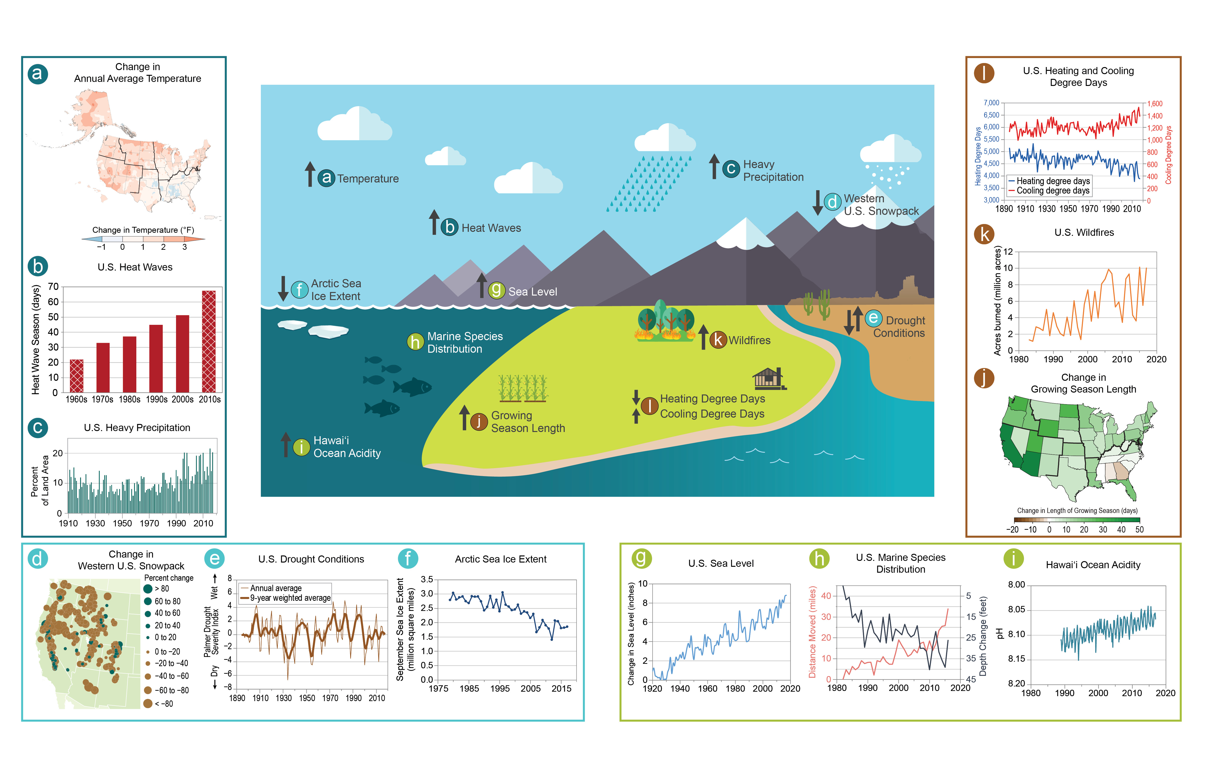
Fig. 1.2: Climate Change Indicators
Ch. 1 | Overview
Long-term observations demonstrate the warming trend in the climate system and the effects of increasing atmospheric greenhouse gas concentrations (Ch. 2: Climate, Box 2.2). This figure shows climate-relevant indicators of change based on data collected across the United States. Upward-pointing arrows indicate an increasing trend; downward-pointing arrows indicate a decreasing trend. Bidirectional arrows (e.g., for drought conditions) indicate a lack of a definitive national trend. For a detailed description of each panel, view the full figure caption online at https://nca2018.globalchange.gov/chapter/1#fig-2. Sources: (a) adapted from Vose et al. 2017, (b) EPA, (c–f and h–l) adapted from EPA 2016, (g and center infographic) EPA and NOAA.

Slide 6
Fig. 1.3: Projected Changes in U.S. Annual Average Temperature
Ch. 1 | Overview
Annual average temperatures across the United States are projected to increase over this century, with greater changes at higher latitudes as compared to lower latitudes, and under a higher scenario (RCP8.5; right) than under a lower one (RCP4.5; left). This figure shows projected differences in annual average temperatures for mid-century (2036–2065; top) and end of century (2071–2100; bottom) relative to the near present (1986–2015). From Figure 2.4, Ch. 2: Climate (Source: adapted from Vose et al. 2017).

Slide 7
Fig. 1.4: Projected Relative Sea Level Change in the United States by 2100
Ch. 1 | Overview
The maps show projections of change in relative sea level along the U.S. coast by 2100 (as compared to 2000) under the lower (RCP4.5) and higher (RCP8.5) scenarios (see CSSR, Ch. 12.5). Globally, sea levels will continue to rise from thermal expansion of the ocean and melting of land-based ice masses (such as Greenland, Antarctica, and mountain glaciers). Regionally, however, the amount of sea level rise will not be the same everywhere. Where land is sinking (as along the Gulf of Mexico coastline), relative sea level rise will be higher, and where land is rising (as in parts of Alaska), relative sea level rise will be lower. Changes in ocean circulation (such as the Gulf Stream) and gravity effects due to ice melt will also alter the heights of the ocean regionally. Sea levels are expected to continue to rise along almost all U.S. coastlines, and by 2100, under the higher scenario, coastal flood heights that today cause major damages to infrastructure would become common during high tides nationwide (Ch. 8: Coastal; Scenario Products section in Appendix 3). Source: adapted from CSSR, Figure 12.4.

Slide 8
Ch. 1 | Overview
1
Climate Change in the United States:
Current and Future Risks
Climate change presents growing challenges to: (1) the economy and our Nation’s infrastructure, (2) the natural environment and the services ecosystems provide to society, and (3) human health and quality of life
Risks posed by climate variability and change vary by region and sector and by the vulnerability of people experiencing impacts
This report characterizes specific risks across regions and sectors in an effort to help people assess the risks they face, create and implement a response plan, and monitor and evaluate the efficacy of a given action

Slide 9
Ch. 1 | Overview
1
Economy & Infrastructure
Many extreme weather and climate-related events are expected to become more frequent and more intense in a warmer world, creating greater risks of infrastructure disruption and failure that can cascade across economic sectors
Regional economies and industries that depend on natural resources and favorable climate conditions, such as agriculture, tourism, and fisheries, are increasingly vulnerable to impacts driven by climate change
Some aspects of our economy may see slight improvements in a modestly warmer world. However, the continued warming that is projected to occur without significant reductions in global greenhouse gas emissions is expected to cause substantial net damage to the U.S. economy, especially in the absence of increased adaptation efforts

Slide 10
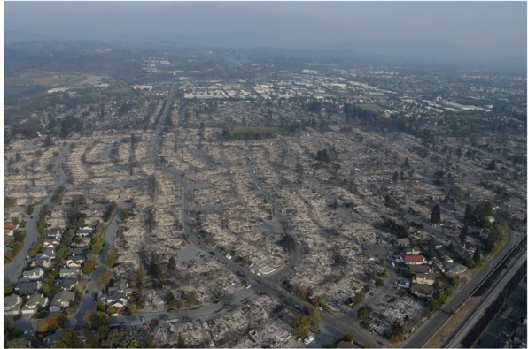
Fig. 1.5: Wildfire at the Wildland-Urban Interface
Ch. 1 | Overview
Wildfires are increasingly encroaching on American communities, posing threats to lives, critical infrastructure, and property. In October 2017, more than a dozen fires burned through northern California, killing dozens of people and leaving thousands more homeless. Communities distant from the fires were affected by poor air quality as smoke plumes darkened skies and caused the cancellation of school and other activities across the region. (left) A NASA satellite image shows active fires on October 9, 2017. (right) The Tubbs Fire, which burned parts of Napa, Sonoma, and Lake counties, was the most destructive in California’s history. It caused an estimated $1.2 billion in damages and destroyed over 5,000 structures, including 5% of the housing stock in the city of Santa Rosa. Image Credits: (left) NASA; (right) Tubbs Fire burn area by Master Sgt. David Loeffler, U.S. Air National Guard.

Slide 11
Fig. 1.6: Widespread Impacts from Hurricane Harvey
Ch. 1 | Overview
Hurricane Harvey led to widespread flooding and knocked out power to 300,000 customers in Texas in 2017, with cascading effects on critical infrastructure facilities such as hospitals, water and wastewater treatment plants, and refineries. The photo shows Port Arthur, Texas, on August 31, 2017—six days after Hurricane Harvey made landfall along the Gulf Coast. From Figure 17.2, Ch. 17: Complex Systems (Photo credit: Staff Sgt. Daniel J. Martinez, U.S. Air National Guard).

Slide 12
Fig. 1.7: Flooding at Fort Calhoun Nuclear Power Plant
Ch. 1 | Overview
Floodwaters from the Missouri River surround the Omaha Public Power District’s Fort Calhoun Station, a nuclear power plant just north of Omaha, Nebraska, on June 20, 2011. The flooding was the result of runoff from near-record snowfall totals and record-setting rains in late May and early June. A protective berm holding back the floodwaters from the plant failed, which prompted plant operators to transfer offsite power to onsite emergency diesel generators. Cooling for the reactor temporarily shut down, but spent fuel pools were unaffected. From Figure 22.5, Ch. 22: N. Great Plains (Photo Credit: Harry Weddington, U.S. Army Corps of Engineers).

Slide 13
Fig. 1.8: Norfolk Naval Base at Risk from Rising Seas
Ch. 1 | Overview
Low-lying Norfolk, Virginia, houses the world’s largest naval base, which supports multiple aircraft carrier groups and is the duty station for thousands of employees. Most of the area around the base lies less than 10 feet above sea level, and local relative sea level is projected to rise between about 2.5 and 11.5 feet by the year 2100 under the Lower and Upper Bound USGCRP sea level rise scenarios, respectively (see Scenario Products section of Appendix 3 for more details on these sea level rise scenarios; see also Ch. 8: Coastal, Case Study “Key Messages in Action: Norfolk, Virginia”). Photo credit: Mass Communication Specialist 1st Class Christopher B. Stoltz, U.S. Navy.

Slide 14
Fig. 1.9: Weather and Climate-Related Impacts on U.S. Military Assets
Ch. 1 | Overview
The Department of Defense (DoD) has significant experience in planning for and managing risk and uncertainty. The effects of climate and extreme weather represent additional risks to incorporate into the Department’s various planning and risk management processes. To identify DoD installations with vulnerabilities to climate-related impacts, a preliminary Screening Level Vulnerability Assessment Survey (SLVAS) of DoD sites worldwide was conducted in 2015. The SLVAS responses (shown for the United States; orange dots) yielded a wide range of qualitative information. The highest number of reported effects resulted from drought (782), followed closely by wind (763) and non-storm surge related flooding (706). About 10% of sites indicated being affected by extreme temperatures (351), while flooding due to storm surge (225) and wildfire (210) affected about 6% of the sites reporting. The survey responses provide a preliminary qualitative picture of DoD assets currently affected by severe weather events as well as an indication of assets that may be affected by sea level rise in the future. Source: adapted from DOD 2018 (http://www.oea.gov/resource/2018-climate-related-risk-dod-infrastructure-initial-vulnerability-assessment-survey-slvas).

Slide 15
Fig. 1.10: Conservation Practices Reduce Impact of Heavy Rains
Ch. 1 | Overview
Increasing heavy rains are leading to more soil erosion and nutrient loss on midwestern cropland. Integrating strips of native prairie vegetation into row crops has been shown to reduce soil and nutrient loss while improving biodiversity. The inset shows a close-up example of a prairie vegetation strip. From Figure 21.2, Ch. 21: Midwest. (Photo credits: [main photo] Lynn Betts; [inset] Farnaz Kordbacheh).

Slide 16
Ch. 1 | Overview
1
Natural Environment & Ecosystem Services
Climate change threatens many benefits that the natural environment provides to society: safe and reliable water supplies, clean air, protection from flooding and erosion, and the use of natural resources for economic, recreational, and subsistence activities
Valued aspects of regional heritage and quality of life tied to the natural environment, wildlife, and outdoor recreation will change with the climate, and as a result, future generations can expect to experience and interact with natural systems in ways that are much different than today
Without significant reductions in greenhouse gas emissions, extinctions and transformative impacts on some ecosystems cannot be avoided, with varying impacts on the economic, recreational, and subsistence activities they support

Slide 17
Fig. 1.11: Impacts of Drought on Texas Agriculture
Ch. 1 | Overview
Soybeans in Texas experience the effects of drought in August 2013. During 2010–2015, a multiyear regional drought severely affected agriculture in the Southern Great Plains. One prominent impact was the reduction of irrigation water released for farmers on the Texas coastal plains. Photo credit: Bob Nichols, USDA.

Slide 18
Fig. 1.12: Desalination Plants Can Reduce Impacts from Drought in Texas
Ch. 1 | Overview
Desalination activities in Texas are an important contributor to the state’s efforts to meet current and projected water needs for communities, industry, and agriculture. The state’s 2017 Water Plan recommended an expansion of desalination to help reduce longer-term risks to water supplies from drought, higher temperatures, and other stressors. There are currently 44 public water supply desalination plants in Texas. From Figure 23.8, Ch. 23: S. Great Plains (Source: adapted from Texas Water Development Board 2017).

Slide 19
Fig. 1.13: Razor Clamming on the Washington Coast
Ch. 1 | Overview
Razor clamming draws crowds on the coast of Washington State. This popular recreation activity is expected to decline due to ocean acidification, harmful algal blooms, warmer temperatures, and habitat degradation. From Figure 24.7, Ch. 24: Northwest (Photo courtesy of Vera Trainer, NOAA).

Slide 20
Fig. 1.14: Severe Coral Bleaching Projected for Hawai’i and the U.S.-Affiliated Pacific Islands
Ch. 1 | Overview
The figure shows the years when severe coral bleaching is projected to occur annually in the Hawaiʻi and U.S.-Affiliated Pacific Islands region under a higher scenario (RCP8.5). Darker colors indicate earlier projected onset of coral bleaching. Under projected warming of approximately 0.5°F per decade, all nearshore coral reefs in the region will experience annual bleaching before 2050. From Figure 27.10, Ch. 27: Hawai‘i & Pacific Islands (Source: NOAA).

Slide 21
Fig. 1.15: Promoting Coral Reef Recovery
Ch. 1 | Overview
Examples of coral farming in the U.S. Caribbean demonstrating different types of structures used for growing fragments from branching corals. Coral farming is a strategy meant to improve the reef community and ecosystem function, including for fish species. The U.S Caribbean Islands, Florida, Hawai‘i, and the U.S.-Affiliated Pacific Islands face similar threats from coral bleaching and mortality due to warming ocean surface waters and ocean acidification. Degradation of coral reefs is expected to negatively affect fisheries and the economies that depend on them as habitat is lost in both regions. While coral farming may provide some targeted recovery, current knowledge and efforts are not nearly advanced enough to compensate for projected losses from bleaching and acidification. From Figure 20.11, Ch. 20: U.S. Caribbean (Photo credits:[top left] Carlos Pacheco, U.S. Fish and Wildlife Service; [bottom left] NOAA; [right] Florida Fish and Wildlife).

Slide 22
Ch. 1 | Overview
1
Human Health & Well-Being
Higher temperatures, increasing air quality risks, more frequent and intense extreme weather and climate-related events, increases in coastal flooding, disruption of ecosystem services, and other changes increasingly threaten the health and well-being of the American people
Risks are often highest for those that are already vulnerable, including low-income communities, some communities of color, children, and the elderly
Future climate change is expected to further disrupt many areas of life, exacerbating existing challenges and revealing new risks to health (including mental health) and prosperity

Slide 23
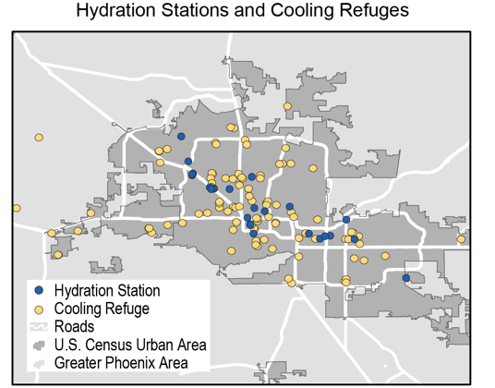
Fig. 1.16: Projected Change in Very Hot Days by 2100 in Phoenix, Arizona
Ch. 1 | Overview
(left) The chart shows the average annual number of days above 100°F in Phoenix, Arizona, for 1976–2005, and projections of the average number of days per year above 100°F through the end of the 21st century (2070–2099) under the lower (RCP4.5) and higher (RCP8.5) scenarios. Dashed lines represent the 5th–95th percentile range of annual observed values. Solid lines represent the 5th–95th percentile range of projected model values. (right) The map shows hydration stations and cooling refuges (cooled indoor locations that provide water and refuge from the heat during the day) in Phoenix in August 2017. Such response measures for high heat events are expected to be needed at greater scales in the coming years if the adverse health effects of more frequent and severe heat waves are to be minimized. Source: adapted from Southwest Cities Heat Refuges (a project by Arizona State University’s Resilient Infrastructure Lab), available at http://www.coolme.today/#phoenix. Data provided by Andrew Fraser and Mikhail Chester, Arizona St Univ.

Slide 24
Fig. 1.17: Community Relocation – Isle de Jean Charles, Louisiana
Ch. 1 | Overview
(left) A federal grant is being used to relocate the tribal community of Isle de Jean Charles, Louisiana, in response to severe land loss, sea level rise, and coastal flooding. From Figure 15.3, Ch. 15: Tribes (Photo credit: Ronald Stine).
(right) As part of the resettlement of the tribal community of Isle de Jean Charles, residents are working with the Lowlander Center and the State of Louisiana to finalize a plan that reflects the desires of the community. From Figure 15.4, Ch. 15: Tribes (Photo provided by Louisiana Office of Community Development).

Slide 25
Fig. 1.18: Adaptation Measures in Kivalina, Alaska
Ch. 1 | Overview
A rock revetment was installed in the Alaska Native Village of Kivalina in 2010 to reduce increasing risks from erosion. A new rock revetment wall has a projected lifespan of 15 to 20 years. From Figure 15.3, Ch. 15: Tribes (Photo credit: ShoreZone. Creative Commons License CC BY 3.0). The inset shows a close-up of the rock wall in 2011. (Photo credit: U.S. Army Corps of Engineers–Alaska District)

Slide 26
Ch. 1 | Overview
1
Reducing the Risks of Climate Change
Many climate change impacts and economic damages in the United States can be substantially reduced through global-scale reductions in greenhouse gas emissions complemented by regional and local adaptation efforts
Since the Third National Climate Assessment (NCA3) in 2014, a growing number of states, cities, and businesses have pursued or expanded upon initiatives aimed at reducing greenhouse gas emissions, and the scale of adaptation implementation across the country has increased
However, these efforts do not yet approach the scale needed to avoid substantial damages to the economy, environment, and human health expected over the coming decades

Slide 27
Fig. 1.19: Mitigation-Related Activities at State and Local Levels
Ch. 1 | Overview
(top) The map shows the number of mitigation-related activities at the state level (out of 30 illustrative activities) as well as cities supporting emissions reductions; (bottom) the chart depicts the type and number of activities by state. Several territories also have a variety of mitigation-related activities, including American Sāmoa, the Federated States of Micronesia, Guam, Northern Mariana Islands, Puerto Rico, and the U.S. Virgin Islands. From Figure 29.1, Ch. 29: Mitigation (Sources: [top] EPA and ERT, [bottom] adapted from America’s Pledge 2017).

Slide 28
Fig. 1.20: Adaptation Stages and Progress
Ch. 1 | Overview
Adaptation entails a continuing risk management process. With this approach, individuals and organizations become aware of and assess risks and vulnerabilities from climate and other drivers of change, take actions to reduce those risks, and learn over time. The gray arced lines compare the current status of implementing this process with the status reported by the Third National Climate Assessment in 2014; darker color indicates more activity. From Figure 28.1, Ch. 28: Adaptation (Source: adapted from National Research Council, 2010. Used with permission from the National Academies Press, © 2010,National Academy of Sciences. Image credits, clockwise from top: National Weather Service; USGS; Armando Rodriguez, Miami-Dade County; Dr. Neil Berg, MARISA; Bill Ingalls, NASA).

Slide 29
Ch. 1 | Overview
1
Advances since NCA3
Expanded regional focus in response to growing demand for localized information:
New chapter dedicated to the U.S. Caribbean, and Great Plains divided into Northern and Southern regions
Draws on NOAA state climate summaries and downscaled projections
Greater visibility to emerging topics, including:
Effects of climate change on U.S. international interests, including trade, national security, and humanitarian assistance
Air quality and climate change
Complex, interconnected human and natural systems
Focus on economic valuation, where possible:
Quantification of climate change impacts in economic terms under different future greenhouse gas emissions scenarios
Does not yet characterize differential economic impacts for all 10 NCA regions
Provides an indication of the potential for reducing risks through mitigation actions

Slide 30
Fig. 1.21: New Economic Impact Studies
Ch. 1 | Overview
Annual economic impact estimates are shown for labor and air quality. The bar graph on the left shows national annual damages in 2090 (in billions of 2015 dollars) for a higher scenario (RCP8.5) and lower scenario (RCP4.5); the difference between the height of the RCP8.5 and RCP4.5 bars for a given category represents an estimate of the economic benefit to the United States from global mitigation action. For these two categories, damage estimates do not consider costs or benefits of new adaptation actions to reduce impacts, and they do not include Alaska, Hawaiʻi and U.S.-Affiliated Pacific Islands, or the U.S. Caribbean. The maps on the right show regional variation in annual impacts projected under the higher scenario (RCP8.5) in 2090. The map on the top shows the percent change in hours worked in high-risk industries as compared to the period 2003–2007. The hours lost result in economic damages: for example, $28 billion per year in the Southern Great Plains. The map on the bottom is the change in summer-average maximum daily 8-hour ozone concentrations (ppb) at ground-level as compared to the period 1995–2005. These changes in ozone concentrations result in premature deaths: for example, an additional 910 premature deaths each year in the Midwest. Source: EPA, 2017. Multi-Model Framework for Quantitative Sectoral Impacts Analysis: A Technical Report for the Fourth National Climate Assessment. U.S. Environmental Protection Agency, EPA 430-R-17-001.

Slide 31
Ch. 1 | Overview
1
Chapter Author Team
Federal Coordinating Lead Author
David Reidmiller, U.S. Global Change Research Program
Chapter Lead
Alexa Jay, U.S. Global Change Research Program
Chapter Authors
Christopher W. Avery, U.S. Global Change Research Program
Daniel Barrie, National Oceanic and Atmospheric Administration
Apurva Dave, U.S. Global Change Research Program
Benjamin DeAngelo, National Oceanic and Atmospheric Administration
Matthew Dzaugis, U.S. Global Change Research Program
Michael Kolian, U.S. Environmental Protection Agency
Kristin Lewis, U.S. Global Change Research Program
Katie Reeves, U.S. Global Change Research Program
Darrell Winner, U.S. Environmental Protection Agency

Slide 32
Jay, A., D.R. Reidmiller, C.W. Avery, D. Barrie, B.J. DeAngelo, A. Dave, M. Dzaugis, M. Kolian, K.L.M. Lewis, K. Reeves, and D. Winner, 2018: Overview. In Impacts, Risks, and Adaptation in the United States: Fourth National Climate Assessment, Volume II [Reidmiller, D.R., C.W. Avery, D.R. Easterling, K.E. Kunkel, K.L.M. Lewis, T.K. Maycock, and B.C. Stewart (eds.)]. U.S. Global Change Research Program, Washington, DC, USA. doi: 10.7930/NCA4.2018.CH1
https://nca2018.globalchange.gov/chapter/overview

